Slide 1
THE SANDWICH

Slide 2
What is an informative text?
It is a short, schematic text, to provide:
instructions
information
rules

Slide 3
INFORMATIVE TEXTS:
LAWS
RULES
INSTRUCTIONS TO BUILD A …
INSTRUCTIONS TO PLAY A GAME
RECIPES
INSTRUCTIONS HOW TO TAKE A MEDICINE

Slide 4
WHAT IS A RULE?
It is an instruction that states the way things are or should be done

Slide 5
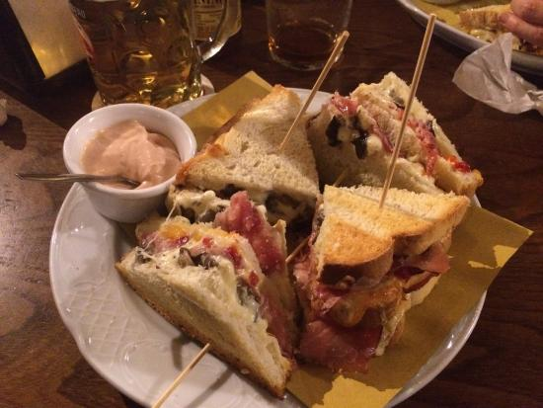
THE SANDWICHES

Slide 6
HISTORY
The sandwich is a British food, made with two slices of bread and butter and stuffed with meat, cheese, ham, vegetables, pickles…
Its name comes from the XVIII century British politician, JOHN MONTAGU, IV earl of Sandwich.

Slide 7
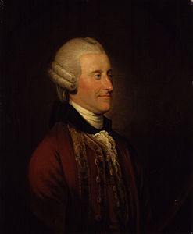
JOHN MONTAGU, IV earl of SANDWICH

Slide 8
Montagu ate sandwiches during golf matches because he didn’t want to stop the games.
He made sandwiches famous!

Slide 9
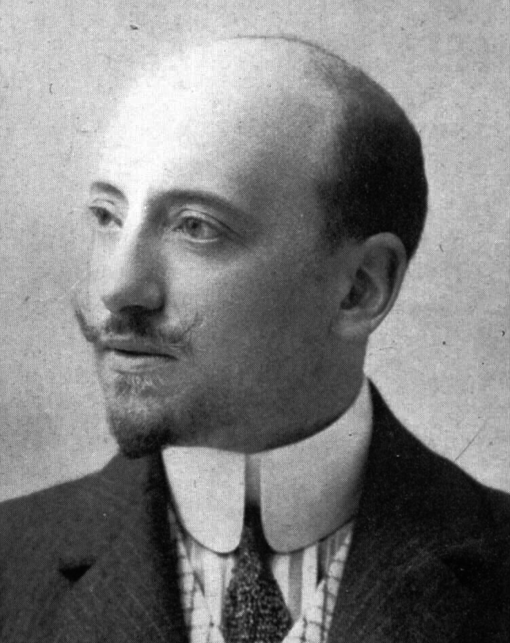
In Italy GABRIELE D’ANNUNZIO, a poet and a writer from the 1900, named the sandwich «TRAMEZZINO».

Slide 10
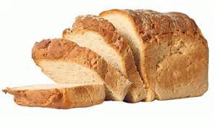
INGREDIENTS
Slices of bread

Slide 11
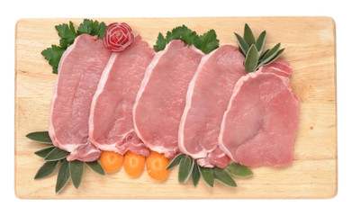
Meat

Slide 12
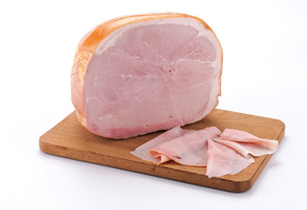
Ham

Slide 13
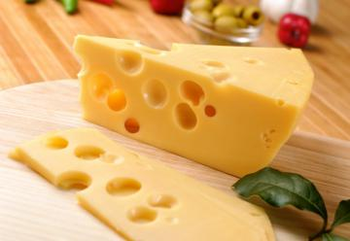
Cheese

Slide 14
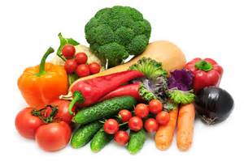
Vegetables

Slide 15
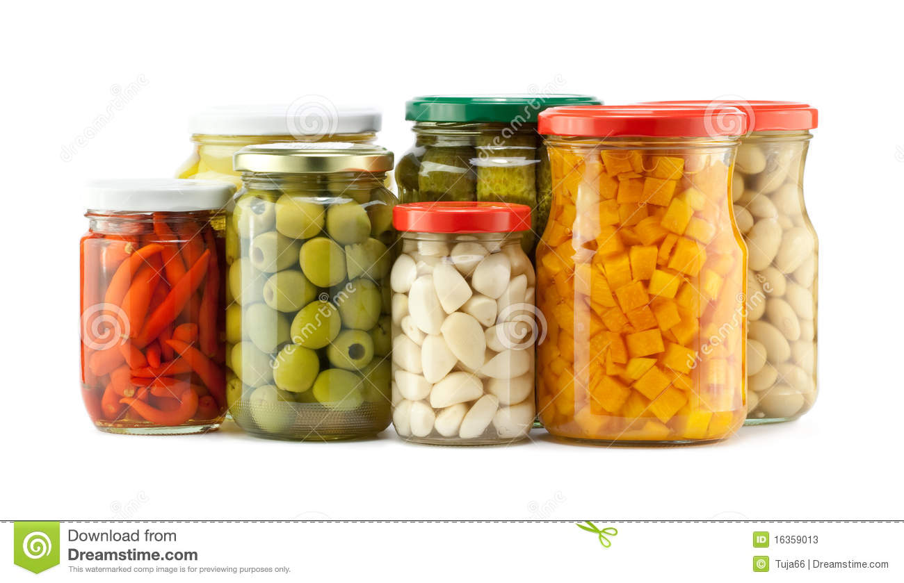
Pickles

Slide 16
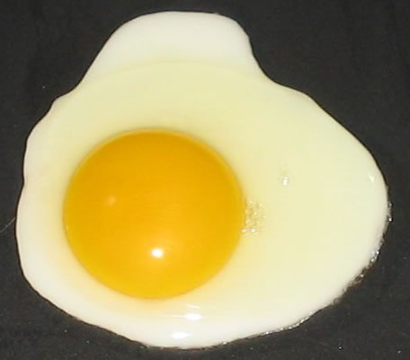
Eggs

Slide 17
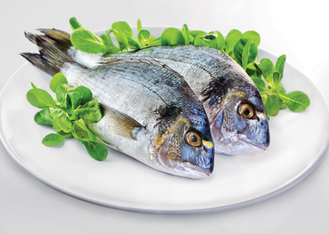
Fish

Slide 18
INSTRUCTIONS
1. TAKE TWO SLICES OF BREAD
2. PUT SOME CHEESE ON THE BREAD
3. PUT SOME HAM ON THE CHEESE
4. PUT SOME VEGETABLES ON THE HAM
5. CLOSE THE SANDWICH WITH A TOOTHPICK
6. PUT AN OLIVE ON THE TOOTHPICK

Slide 19
NUTRITIONAL INFORMATION
BREAD CARBOHYDRATES
MEAT, HAM and FISH PROTEINS
CHEESE PROTEINS and FAT
VEGETABLES FIBERS
All these ingredients are good for your health, but don’t eat too many sandwiches!

Slide 20
ANSWER
1. This recipe is for
a. Sandwiches b. Cakes
2. You need…
a. Slices of fish b. Slices of bread
3. The sandwiches are famous because…
a. J. Montague ate them during golf matches
b. The King ate them in Parliament

Slide 21
4. How did D’Annunzio call the «Sandwich»?
a. Tramezzino b. Panino
5. Do you like sandwiches?
a. Yes, I do b. No, I don’t

