Slide 1
CLIL 2016/17
“READY, STEADY, GO”
3° A/B PROVEZZE
I.C. PROVAGLIO D’ISEO
Insegnanti: Simonetti Dario e Piscioli Elena

Slide 2
WARM UP
FIRST STEP: VOCABULARY
SECOND STEP: EXPLANATION
THIRD STEP: CONSOLIDATION

Slide 3
FIRST STEP:VOCABULARY
Teachers proposed to the class some game-related activities (use of flash cards, What's missing ?, Simon says, mime, guess the action, touch your ...) and songs, to review the familiar vocabulary about body, numbers and actions of the school day (sit down, stand up…) Links
https://www.youtube.com/watch?v=FkL8j0wIRf8&list=PL0VE_cI7-AYTzBmhpILrTz9NZTZXfJpju
https://www.youtube.com/watch?v=QkHQ0CYwjaI
https://www.youtube.com/watch?v=ot4mJ_qUNMY
https://www.youtube.com/watch?v=7y_TUJy2TY8

Slide 4
SECOND STEP:EXPLANATION
Pupils were involved in activities which helped them learn specific vocabulary about actions (run, climb, jump, skip, walk , turn left, go straight on, go back, go forward…) In the classroom they played and mimed the actions using songs. They created special signs with verbs and illustrations.

Slide 5
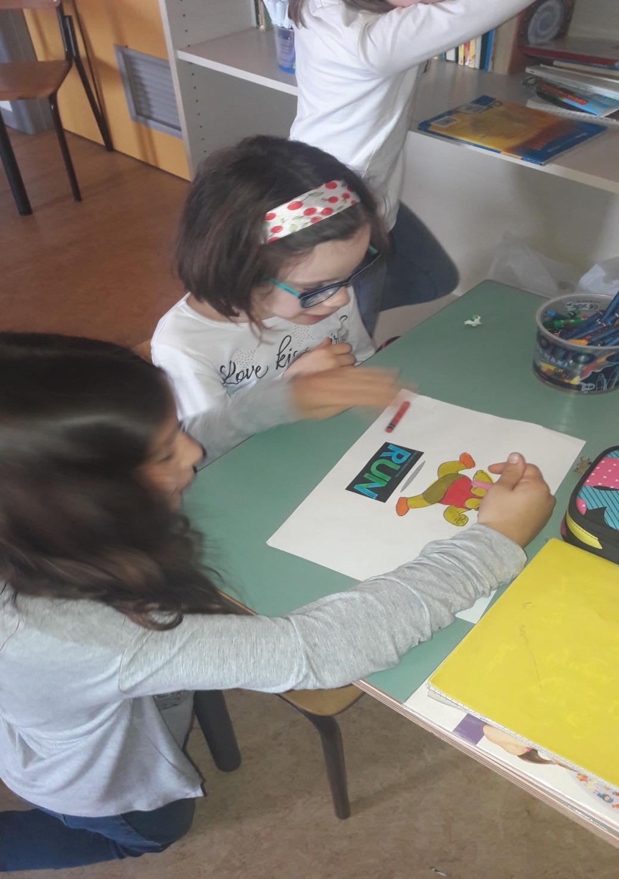

Slide 6
In the gym they practiced routes and games, through pair and group activities, guided by the teacher.

Slide 7
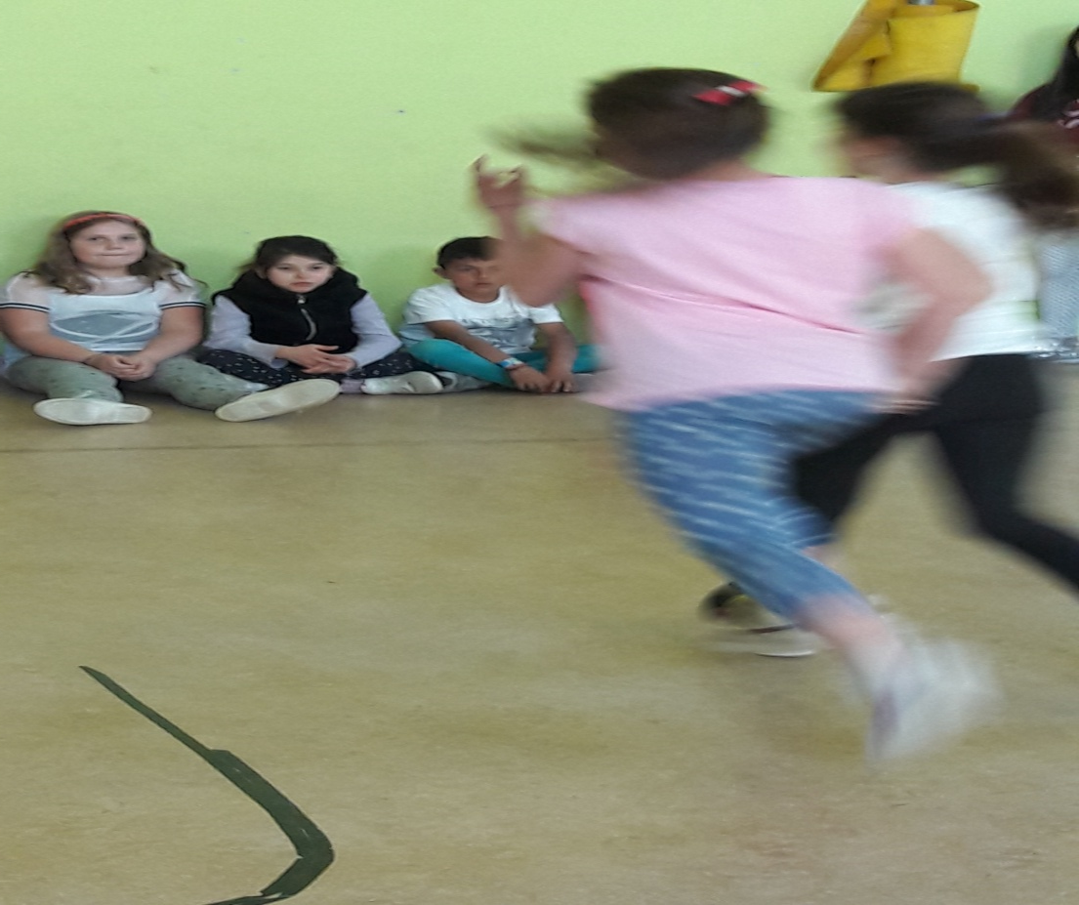

Slide 8
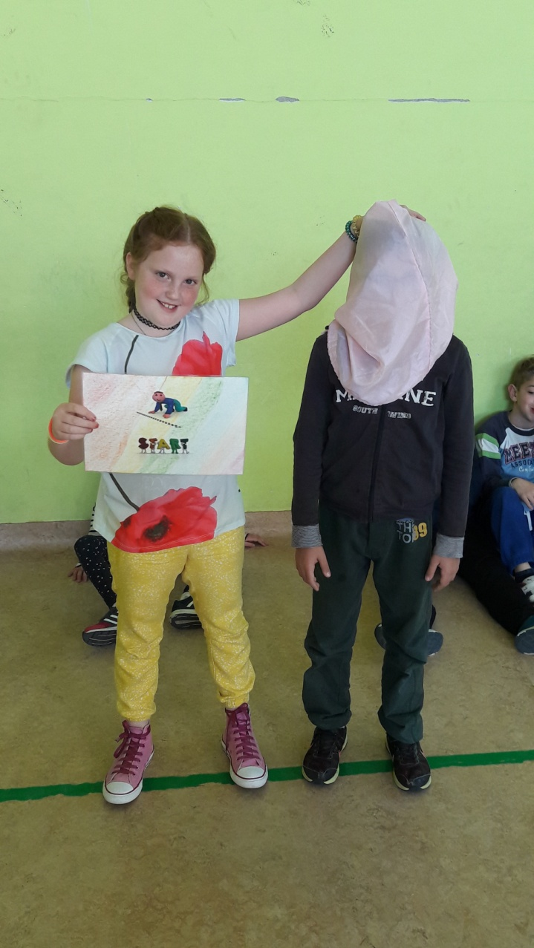
THIRD STEP:CONSOLIDATION
Pupils consolidated the new vocabulary by creating their own game - route in the gym and through role-playing exercises.

Slide 9
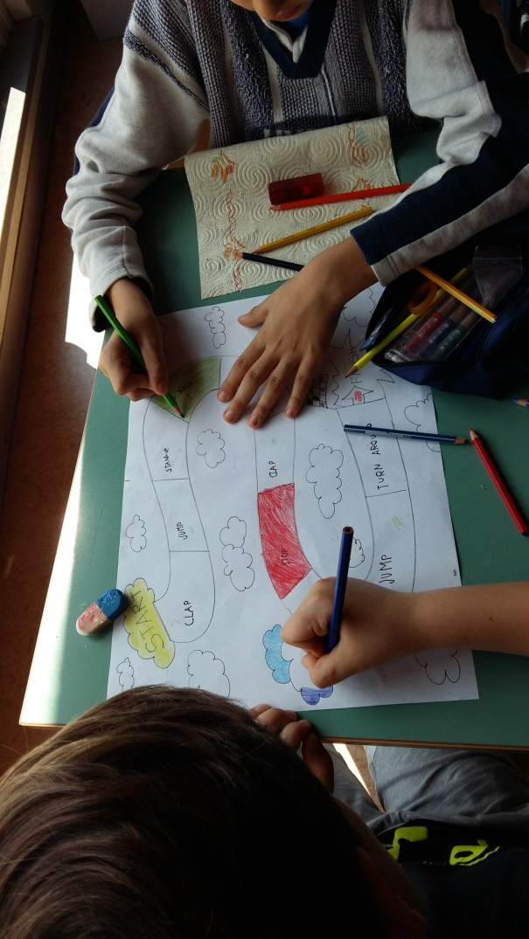
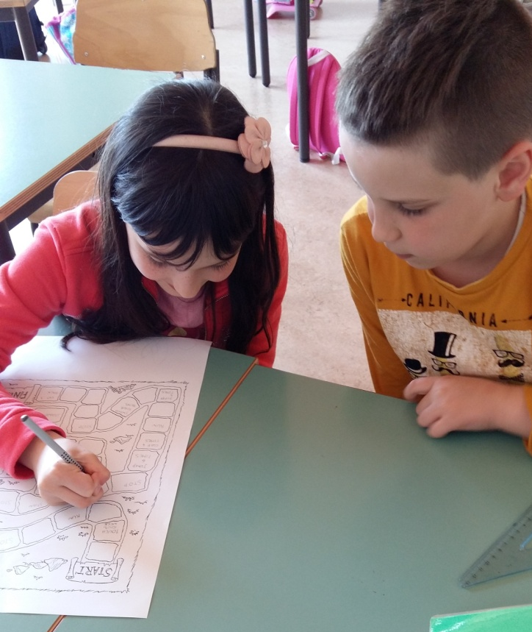
LEARNING BY DOING

Slide 10
FOURTH STEP: TEAM WORK
https://www.youtube.com/watch?v=dUXk8Nc5qQ8
Pupils observed the pictures of the typical English game "Snakes and Ladders”, recognizing it as similar to the Italian "Goose Game".
Pupils built the Goose Game, using all the instructions which they knew and then they gave a copy to the seven classes at the school .

Slide 11
Work has been divided into two steps:
A- Pupils chose the length of the game and the instructions to be included in the boxes, according to the different levels of English knowledge of each classes.
B- Pupils, divided into pairs or small groups, created their own boardgame, all different in form, length and difficulty. They incorporated all the instructions with strategy and creativity.
They made the die and chose some buttons as pawns.

Slide 12
FEEDBACK

Slide 13
FIFTH STEP: TESTING AND EVALUATION
During the final step, pupils experimented with the game they created, under the teacher’s observation and evaluation.
Pupils gave a copy of the game to each class in the school and they demonstrated its rules and how it works, with a simple presentation.

Slide 14
PRESENTATION to the CLASS
This is the “Goose Game” in English, built entirely by us.
This is a present for you. With it, you can have fun during your free time. The game includes the board, die and pawns. Behind the board you can find the rules of the game. Have fun!!!!
Rules of the game:
1. You need more than one player. 2. Each player must have a pawn. 3.Roll the die and move the pawn onto the board. 4. Follow the directions on the boxes. 5. The winner is the first to the “finish box”.

