Slide 1
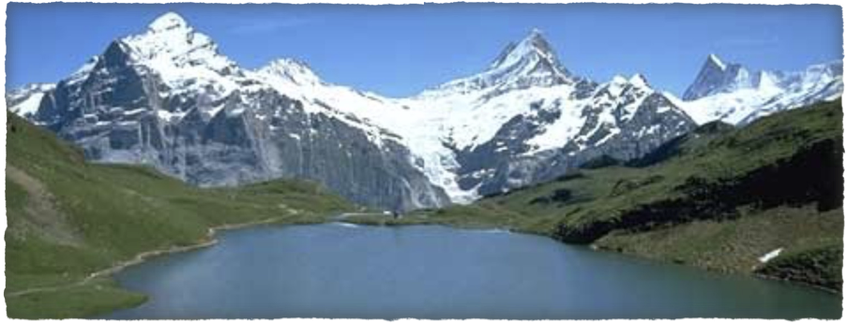
The Alpes
Clil project

Slide 2
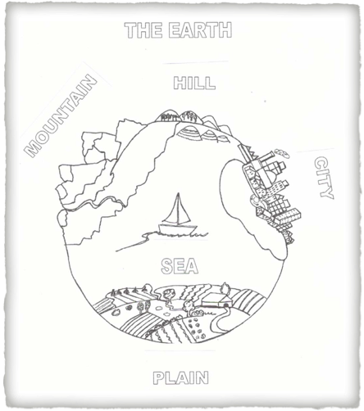
The Earth has got different areas:
The mountain
The sea
The city
The plain
The hill

Slide 3
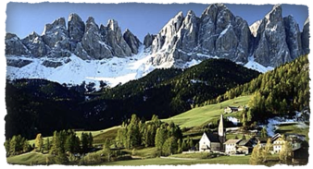
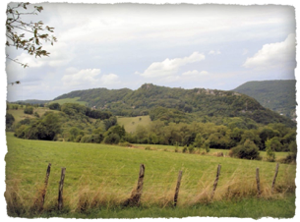
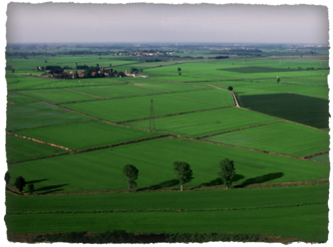
What is it?

Slide 4
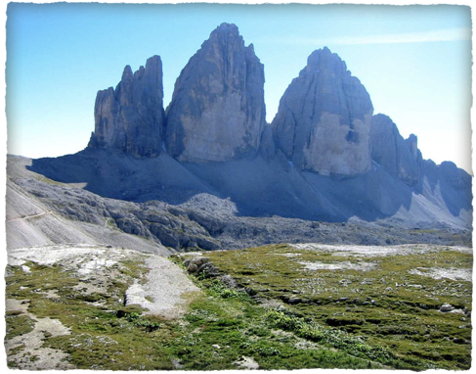
THE ALPES
The Alpes are a mountain range in The north of Italy

Slide 5
The mountains have an altitude(1)of 600 m. The peaks (2) are sharp and the slopes (3) are steep.
On the highest peaks the snow never melts.
This happens because the higher the peak the colder the air becomes.

Slide 6
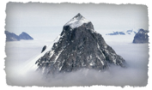
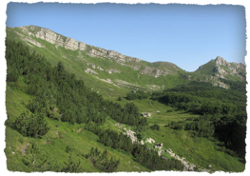
Important:
ALTITUDE: The highest level.
PEAK: The highest point of a mountain.
SLOPE: the steepest part of a mountain.

Slide 7
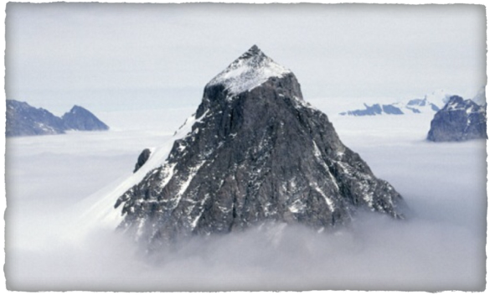
GLOSSARY
PEAK: The pointed top of a mountain

Slide 8
Mountain
a natural elevation greater than 600 meters

Slide 9
Mountain range
Many mountains in a line

Slide 10
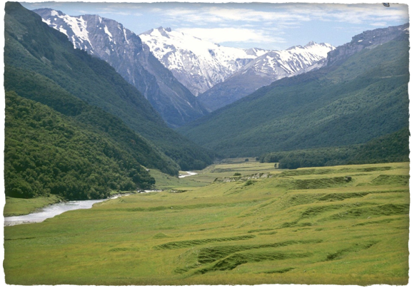
VALLEY
Space between two mountains.

Slide 11
GLACIER
Large mass of frozen snow

Slide 12
REFUGE
A mountain house for animals or people

Slide 13
FOOT
The lowest part of the mountain.

Slide 14
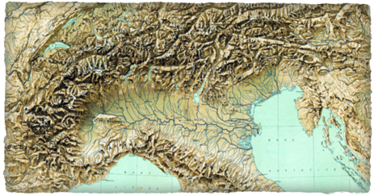
Where are the Alpes?
Switzerland
North
Austria
Slovenia
West
East
France
South

Slide 15
Mountain sports

Slide 16
Skiing

Slide 17
Snowboarding

Slide 18
Skating

Slide 19
Walking

Slide 20
Climbing

Slide 21
