Slide 1
Maps and symbols
By classes 3^ B – D
Rovato cap

Slide 2
We DISCOVER the map of our city , ROVATO.

Slide 3
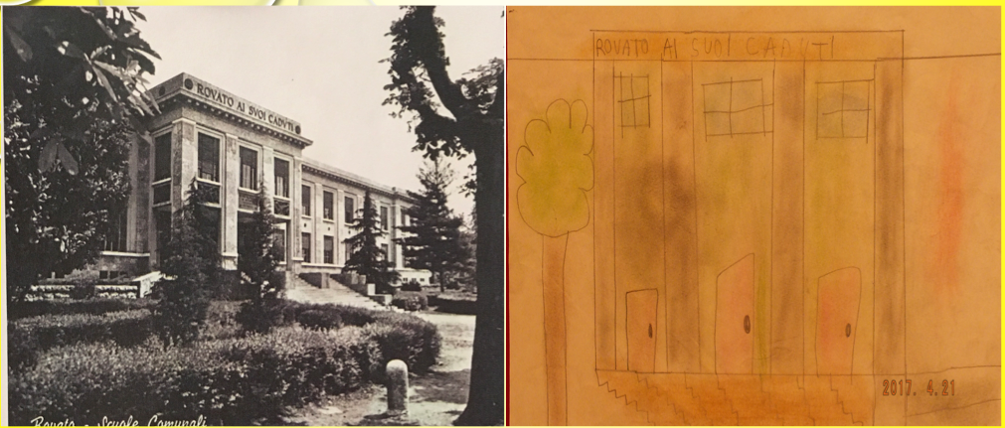
We locate the Places we know ON THE MAP

Slide 4
Then we LOOK AT the poster of warkdale town

Slide 5
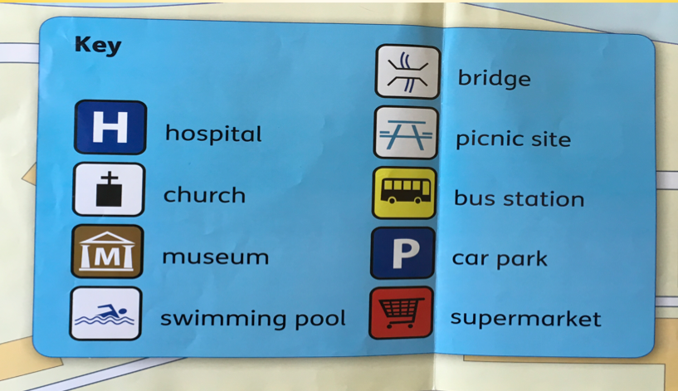
These are the symbols that we LEARN by looking at the map.

Slide 6
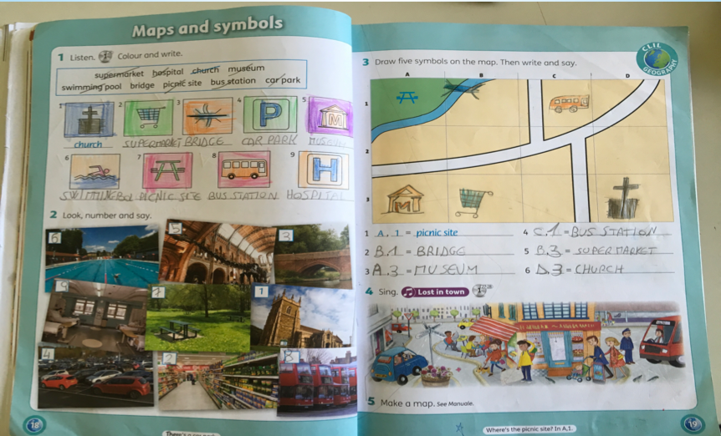
At First We work on our book,

Slide 7
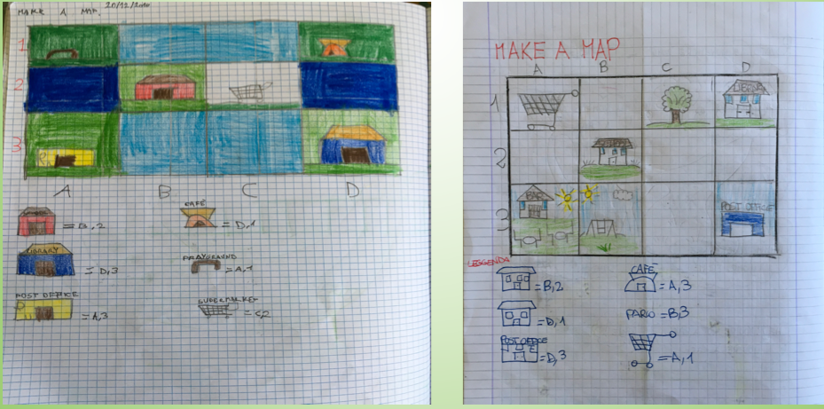
Then we create our map

Slide 8
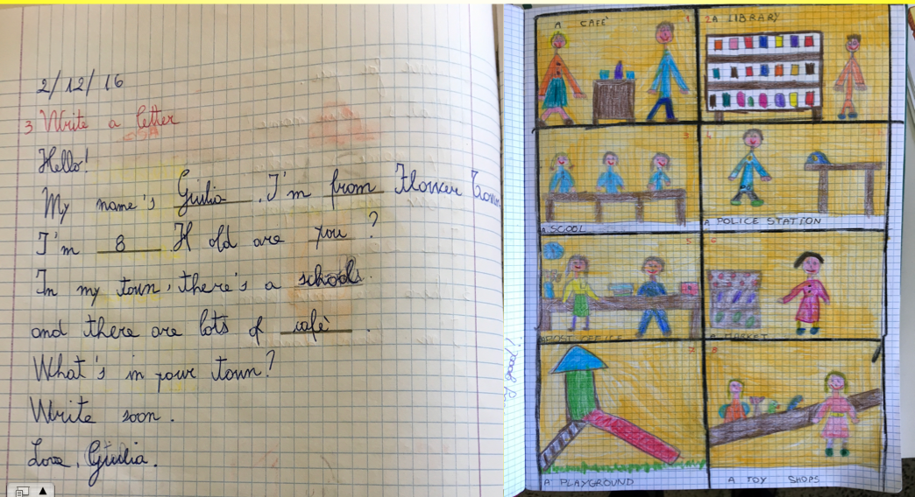
And we write a letter to describe rovato.

Slide 9
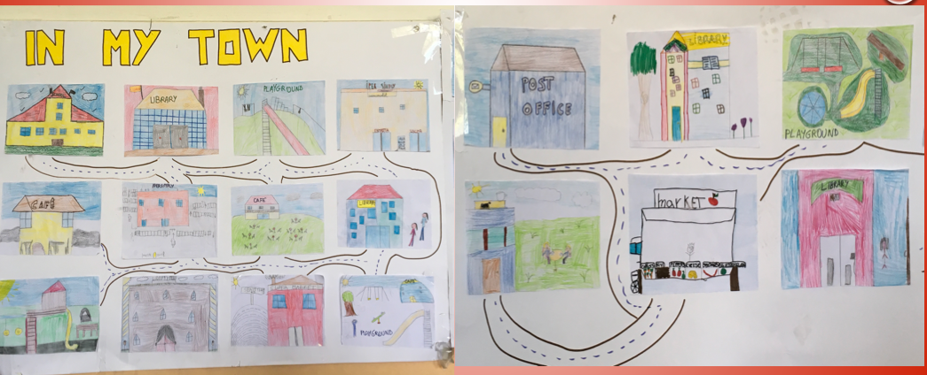
Finally… this is our city.

Slide 10
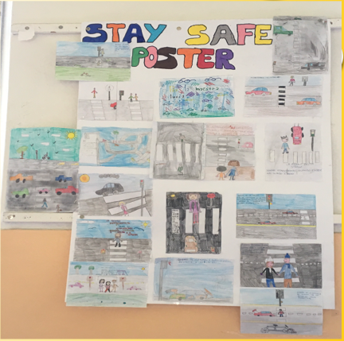
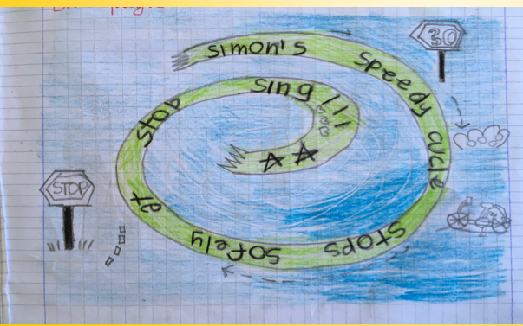
Now we know our city and we can Cycle in safety

