Slide 1
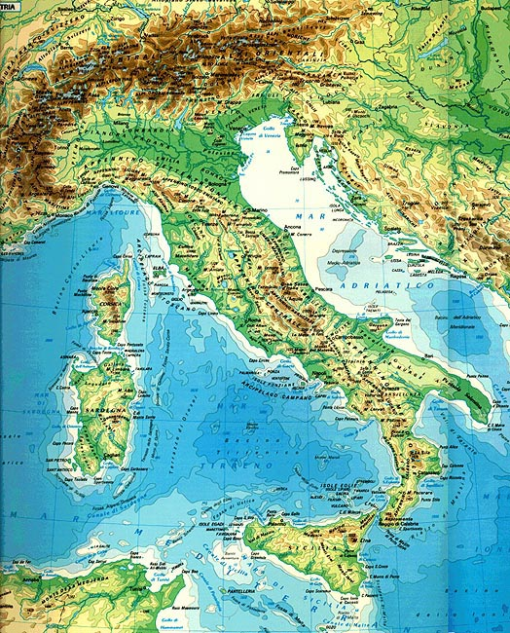
Italian landscapes

Slide 2
LESSON 1: OUR LANDSCAPE
INTRODUCTION: Teacher captures children’s interest.
PROCEDURE: Children look around.
At the end the teacher
- Ask: what can you see? Are there any mountains?, hills?, buildings?...
ACTIVITY: Children sit down in a circle and look towards the front drawing everything they can see.
LANGUAGE STRUCTURE AND VOCABULARY: sit down in a circle; look around; what have you seen?; Now draw it on your notebook.
MATERIALS: notebooks and pencils.
TIMING: 2 hours
Italian Landscapes.docx

Slide 3
LESSON 2: OUR LANDSCAPE
PROCEDURE: Children watch some pictures.
At the end, the teacher asks them to compare their drawings with the pictures shown on the whiteboard (LIM) and spot the differences.
ACTIVITY: they watch some videos to learn more about landscapes, while they watch, they have to pay attention at the landascapes name and meanings;
The teacher asks about the names, if someone already know some words such as “river”, for example…
At the end, children draw some landscapes and write the meaning on their exercise book.
From youtube:
https://youtu.be/pkjJsYsy5cA
https://youtu.be/yxU748R4Mkw
https://youtu.be/mw9YIFoDzww

Slide 4
LANGUAGE STRUCTURE AND VOCABULARY: Let’s watch some pictures: What have you seen? They are different landscapes! Why are they different? The difference is between natural landscapes and others were we can see the presence of man. Can you remember the name of some landscapes? For example: river, mountains, plain, ….
If you don’t remember, I can help you … let’s watch some flashcards and repeat after me …. This is a river, mountain, plain, …
MATERIALS: videos and file word:
Exercise books; pencils, colours, rubber, sharpener, ….
Set of cards made by teachers.
TIMING: 2 hours

Slide 5
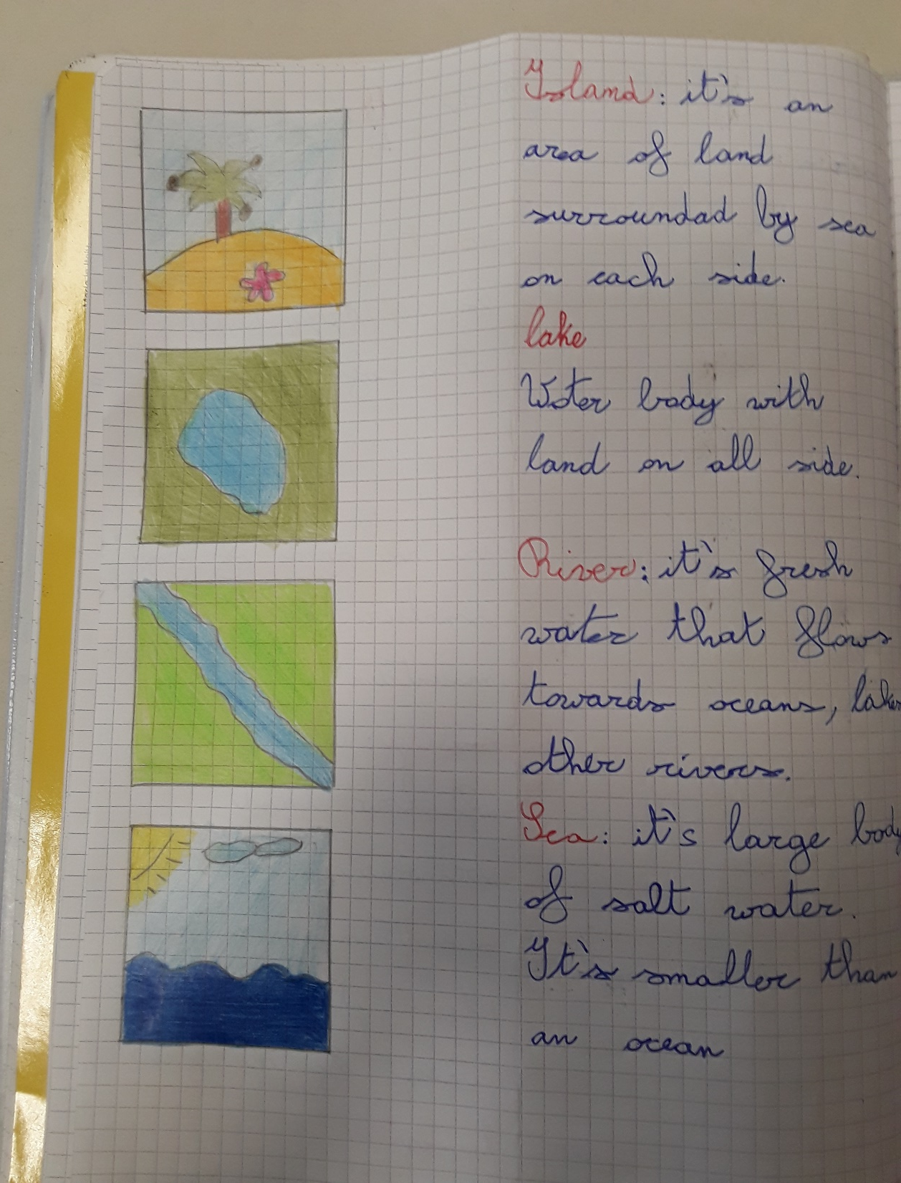

Slide 6
LESSON 3: OUR LANDSCAPE
PROCEDURE: building knowledge.
ACTIVITY: they repeat the name and the meaning of some landscapes using some cards; then divided in groups of four or five children, each group have different work such as puzzle game, match the line or memory game. At the end, the teacher give them a text about Italian Landscape with some exercises such as “true/false” or “put a tick”.
LANGUAGE STRUCTURE AND VOCABULARY: Look at the pictures and repeat after me: this is a mountain, river, plain…. Now, you know the name of some landscapes but if I ask you: I’m a water body with land on all side…… Who am I?; I’m an area of low land between two mountains or hills …. Who am I? Very good! Now, let’s work and have fun! Complete the exercises. “Find the landforms in the puzzle”; “Draw a line to match the landform word to the picture”; play with the memory game. Listen the text about Italian landscapes and answer with T/F or put a tick.
MATERIALS: set of cards, worksheets, memory game.
TIMING: 2 hours

Slide 7
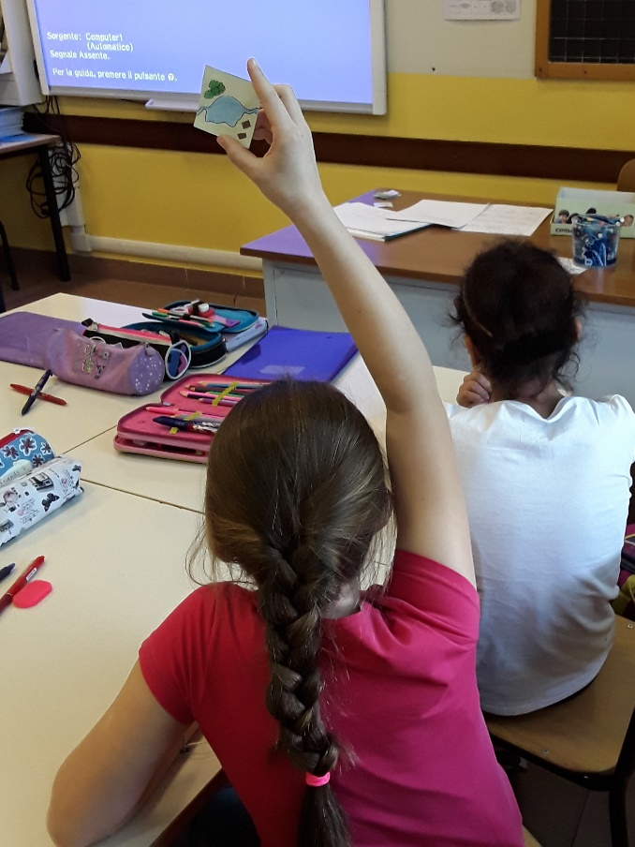
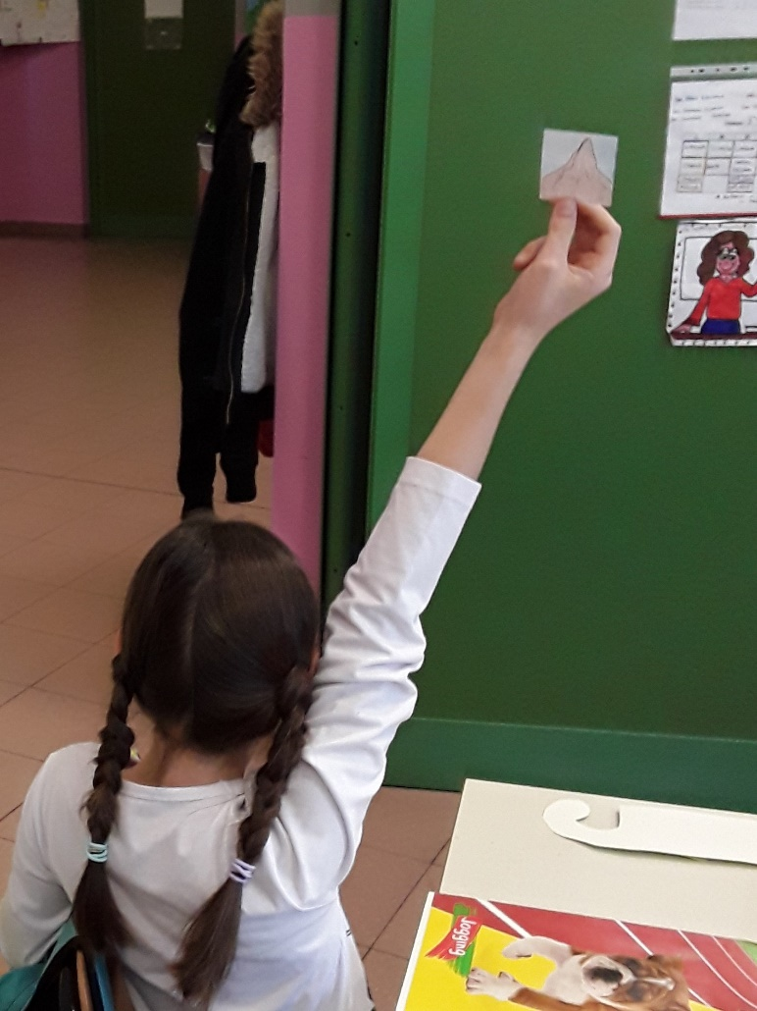
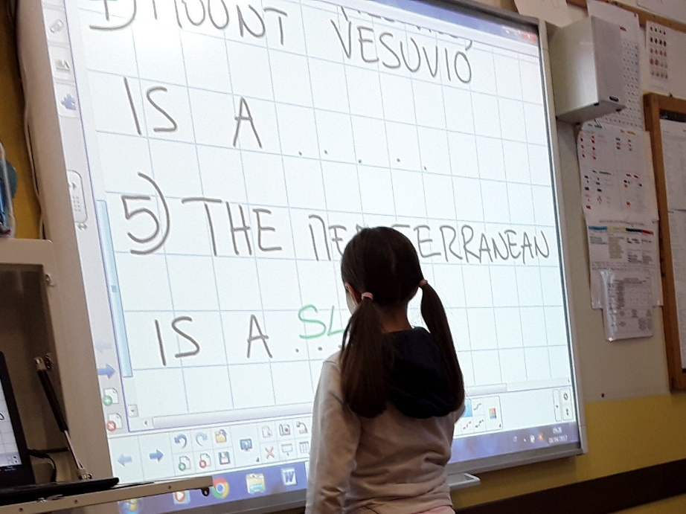

Slide 8
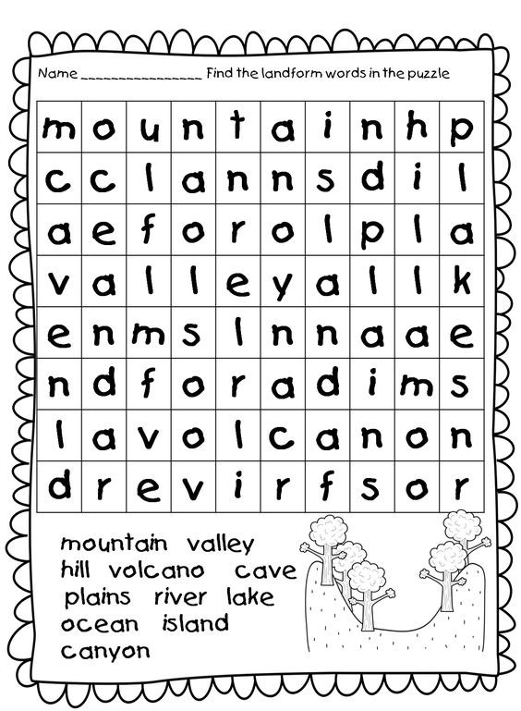
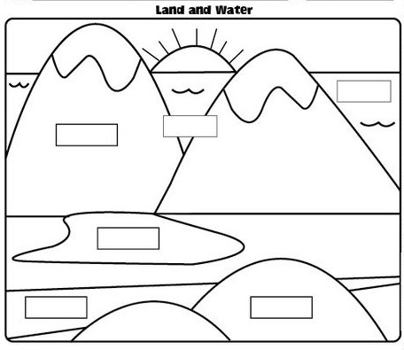
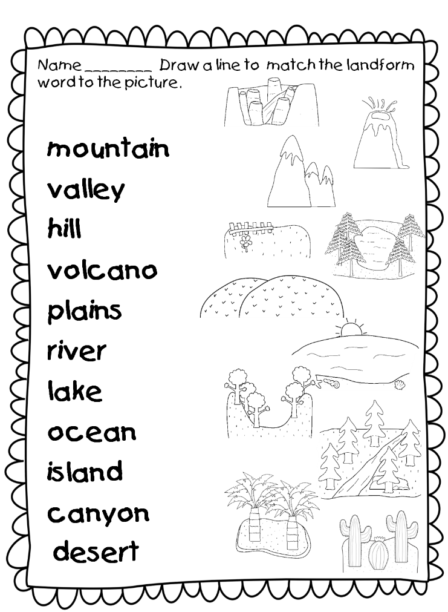

Slide 9
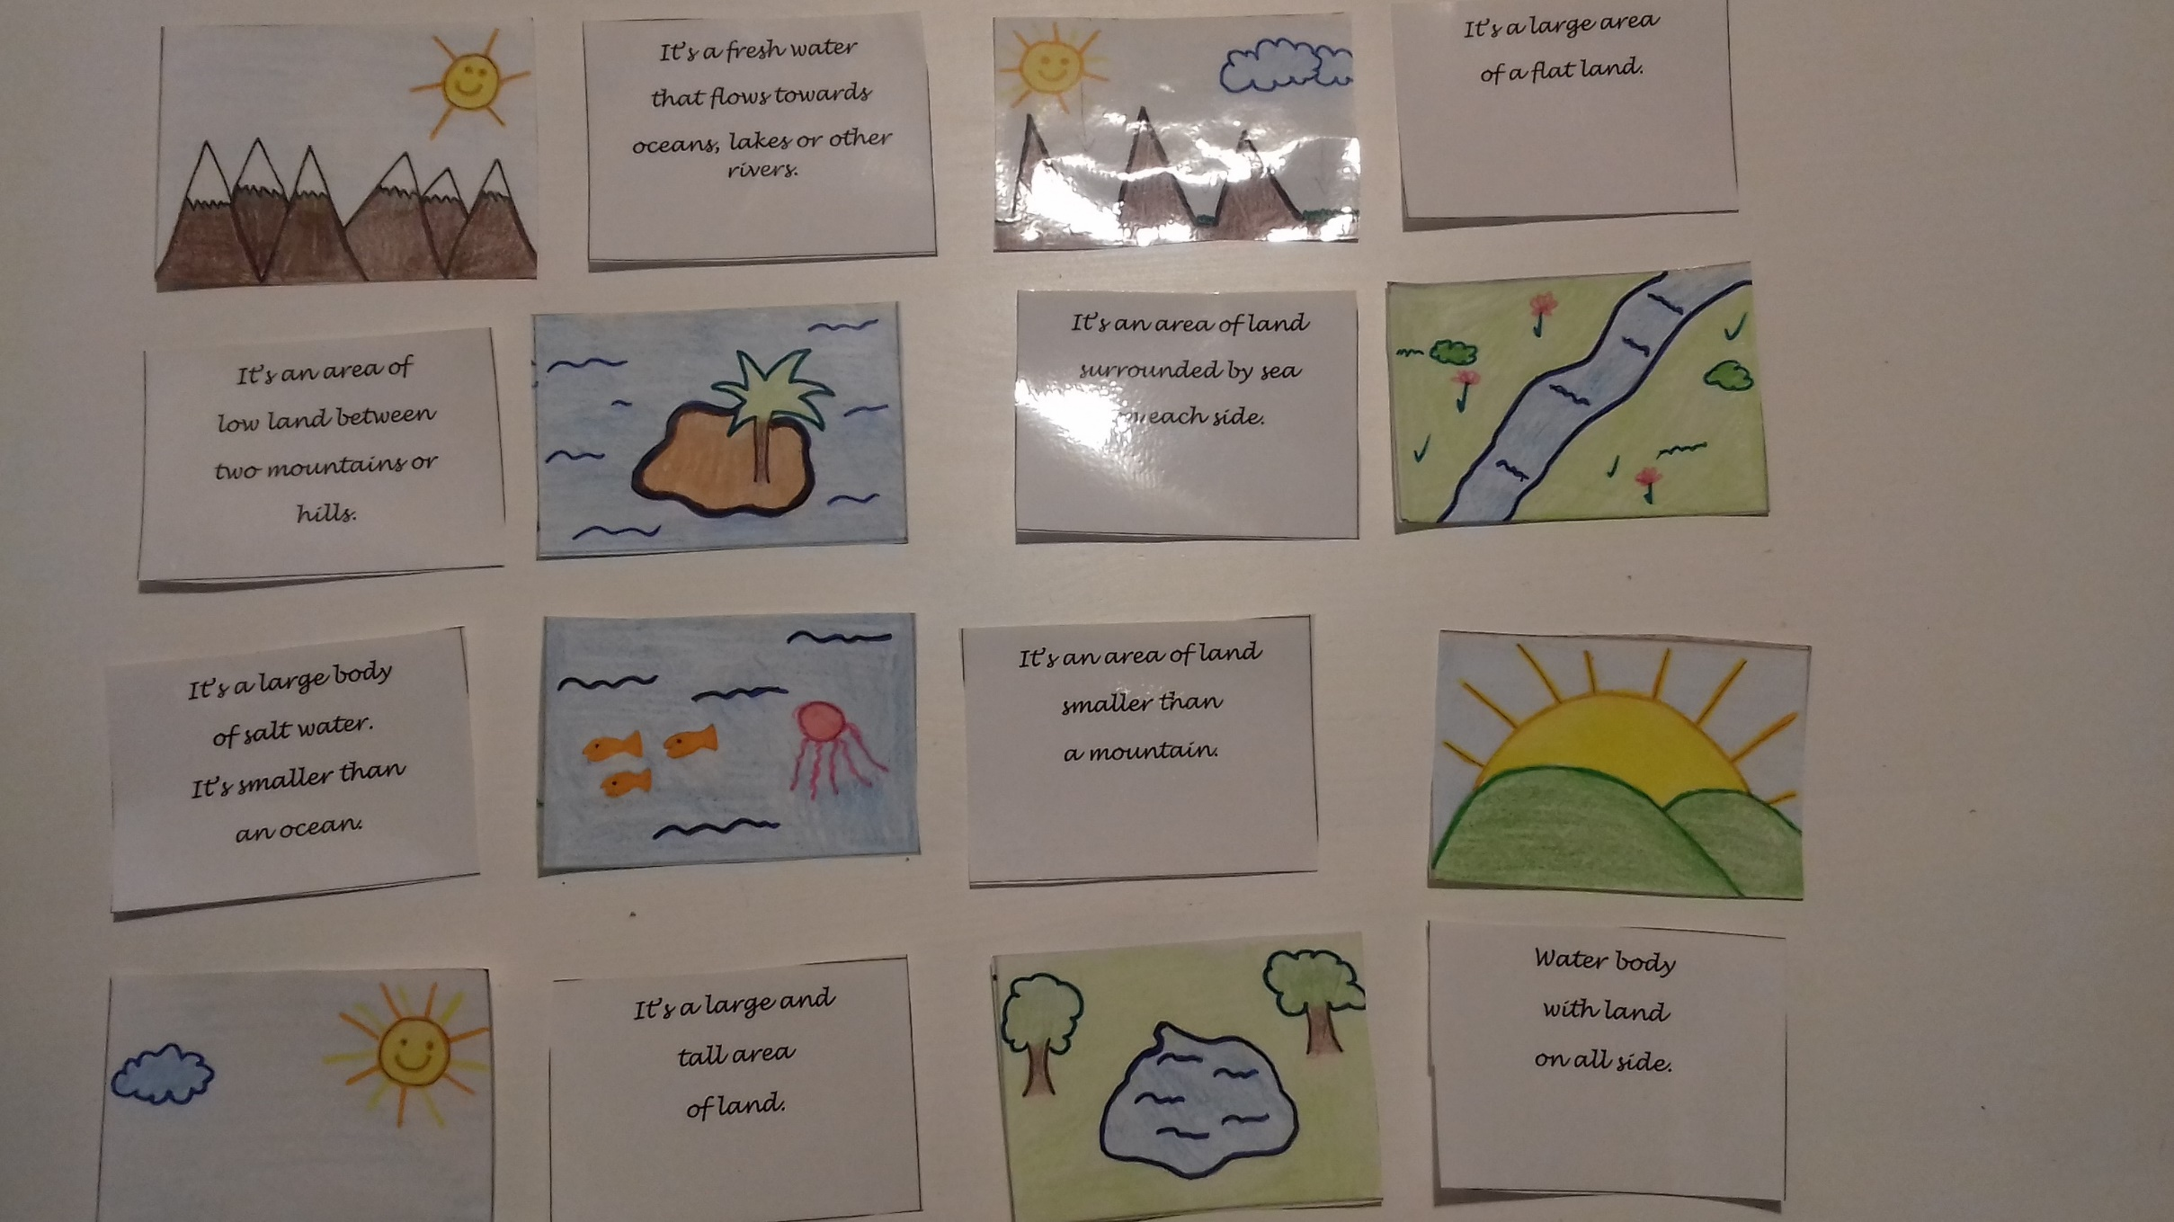

Slide 10
LESSON 4: OUR LANDSCAPE
PROCEDURE: Feedbacks. Children learned new knowledge and they practised about contents.
ACTIVITY: the teacher introduces a game, she gives some clues and while the children are divided in groups, they listen and act out. The t. gives the last worksheet about landforms and bodies of water and at last but not least the “expertise task”. The t. gives a geographic map of Italy and the children have to draw and colour the landforms and bodies of water that they have learned on the map.
LANGUAGE STRUCTURE AND VOCABULARY: Let’s start with a game! Listen and act out: If you are a body of water … sit down; if you are a landform ….. stand up; if you are a river …. go to the right; if you are a mountain …. go to the left; if you are a plain …. clap your hands; …….
Listen, repeat and write the name under the picture then colour; read and complete the sentences. Look at the geographic map and try to draw every landforms and bodies of water that you can remember then colour.
MATERIALS: worksheets, pencils, ….
TIMING: 2 hours

Slide 11
