Slide 1
CODING
What is coding?
Coding gives students the opportunity to practice computational thinking: they learn to think like a computer, which executes instructions to start a program.
Children do activities in which they have to follow instructions do to something (for example a picture), like a computer.

Slide 2
STORYTIME
Let’s start with a story!
Flurry has lost his way
Flurry, a small ball of fur coming from planet Colourix, has lost his way.
He has come on Earth with his family, on vacation, by an amazing oval space shuttle.
One day, while playing with his brothers and sisters, he suddenly found himself alone in the wood.
The alien is very sad. He calls out loud his mum and dad, but nobody answers.
He tries to find his way, but he can only see lots of trees around him.
Flurry turns right, turns left, goes forward and backwards. there are lots of obstacles to overtake and he doesn’t know how to do it!
Will you help him find his way?

Slide 3
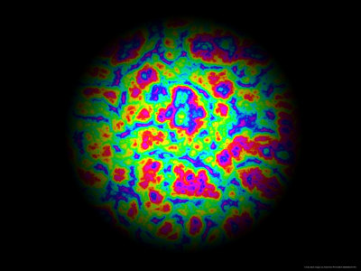
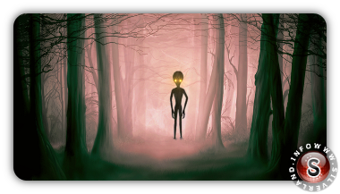
PLANET COLOURIX
FLURRY
SHUTTLE
ALONE IN THE WOOD

Slide 4
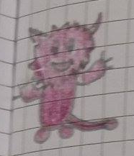
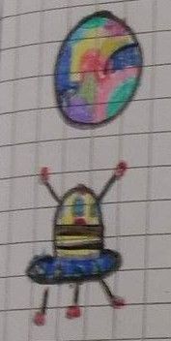
STORY SEQUENCES
Flurry is an alien
He arrived from Colourix with his shuttle

Slide 5
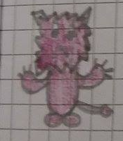
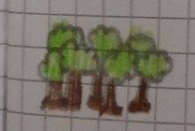
One day he gets lost in the wood. He’s alone and sad.
There are many obstacles. Flurry needs help!

Slide 6
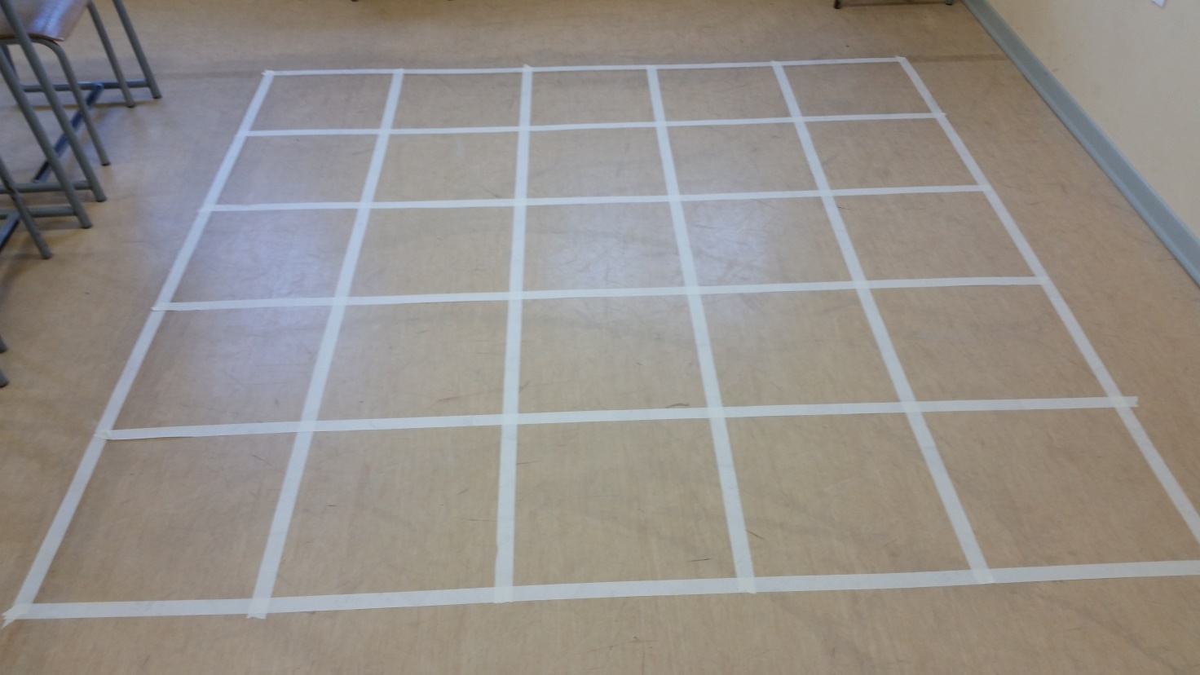
Let’s do a grid on the floor, this is the wood.

Slide 7
LET’S LEARN DIRECTIONS
Move forward
Turn right
Turn left

Slide 8
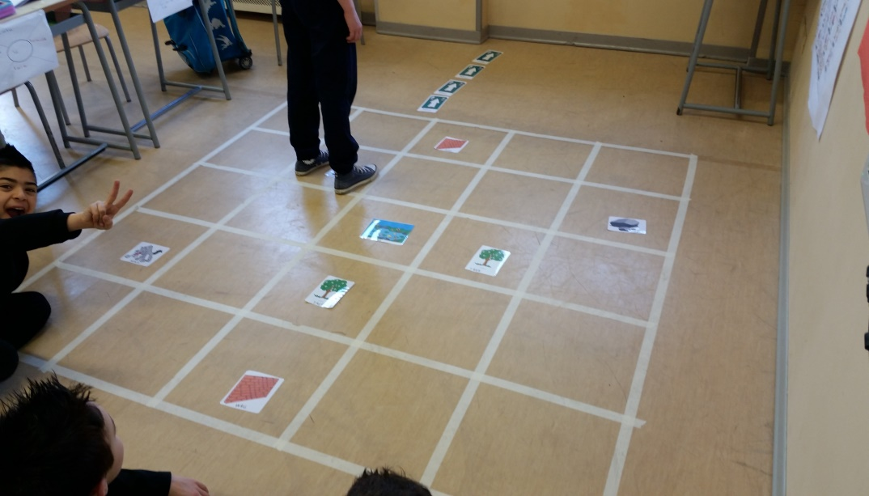
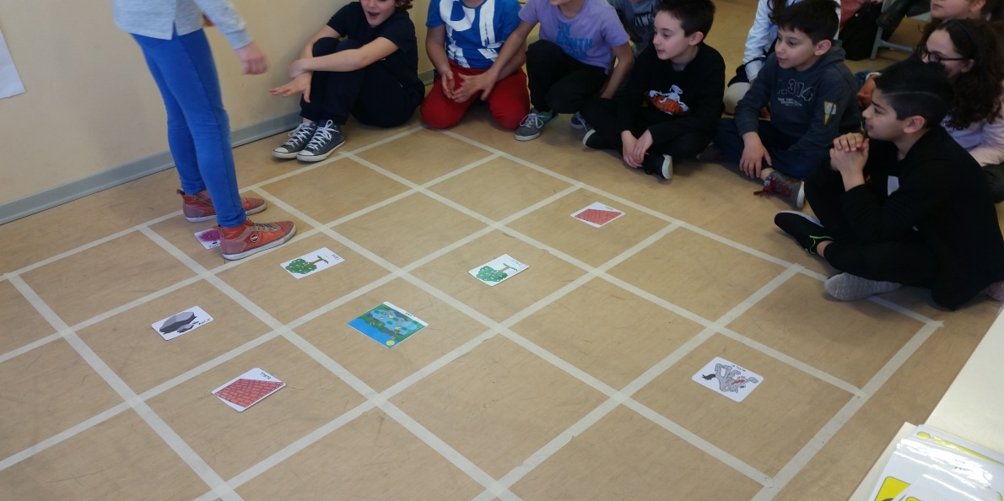
On the floor there are many obstacles (lake, wall, wolf,…).
Children give directions to Flurry to help him avoiding obstacles and reach his destination

Slide 9
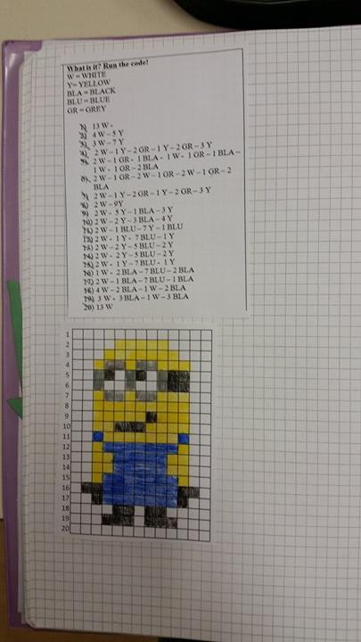
Children enjoy themselves with pixel art and
make drawings using a code.

Slide 10
What is it?
Run the code!
LEGEND
R = red
BR = brown
BLA= black
BLU= blue
P = pink
W = white
Y = yellow
4W – 6R
3W – 10 R
3W – 3 BR – 3 P - 1 BLA – 1 P
2W – 1 BR – 1 P – 1 BR – 4 P – 1 BLA – 3 P
2W – 1 BR – 1 P – 2 BR – 4 P – 1 BLA – 3 P
3 W – 1 BR – 5 P – 4 BLA
4 W – 8 P
3 W – 2 R – 1 BLU – 2 R – 1 BLU – 2 R
2W - 3 R – 1 BLU – 2 R – 1 BLU – 3 R
1W – 4 R – 4 BLU – 4 R
1 W - 2 P - 1 R - 1 BLU – 1 Y – 2 BLU – 1 Y – 1 BLU – 1 R – 2 P
1 W – 3 P – 6 BLU - 3 P
1 W – 2 P - 8 BLU – 2 P
3 W - 3 BLU – 2 W – 3 BLU
2 W – 3 BR – 4 W – 3 BR
1 W – 4 BR – 4 W – 4 BR
FOR EXAMPLE THIS IS SUPER MARIO’S CODE

Slide 11
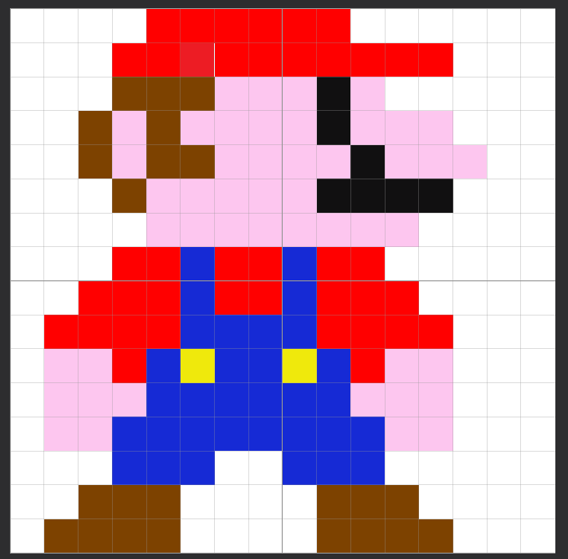

Slide 12
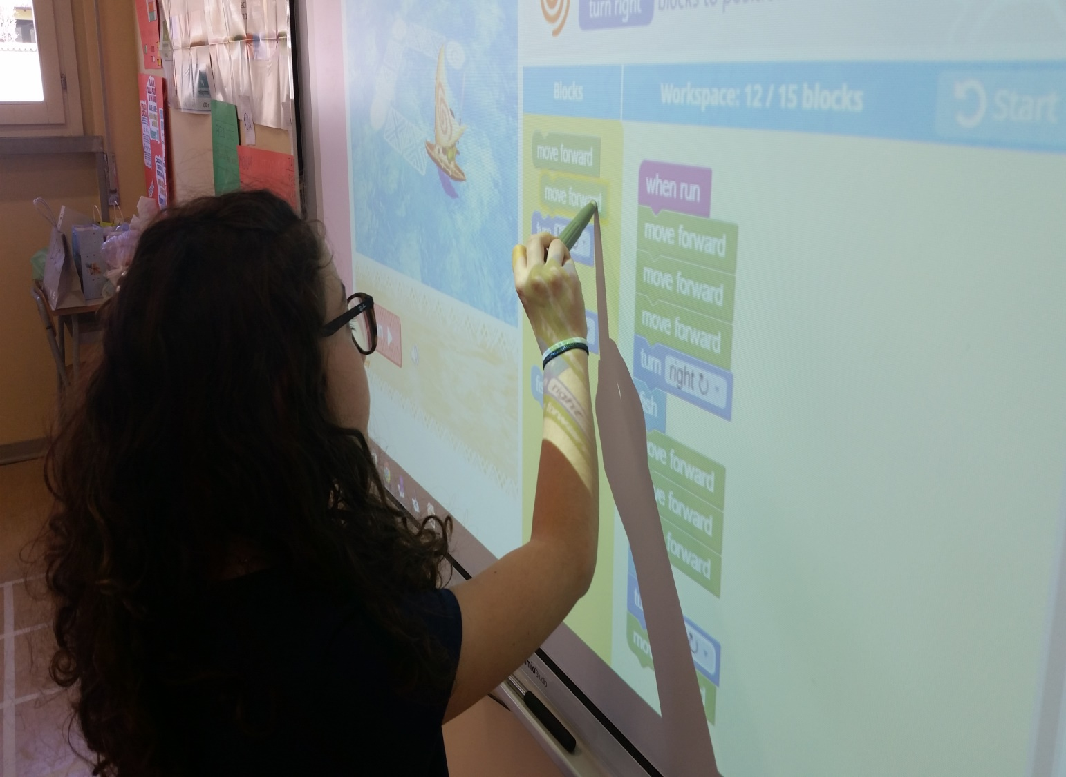
Children play interactive coding games on the web (code.org).

Slide 13
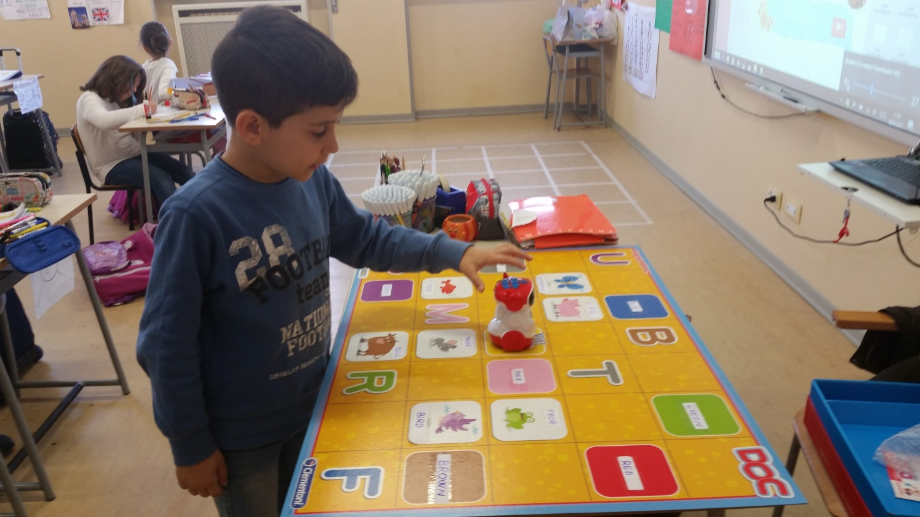
Children have to program the movements of a little robot.

Slide 14
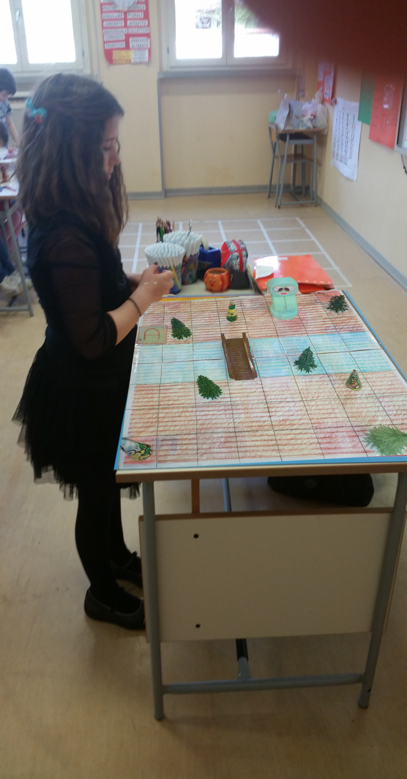
At the end children realize a big grid with
an object as place card.

Slide 15
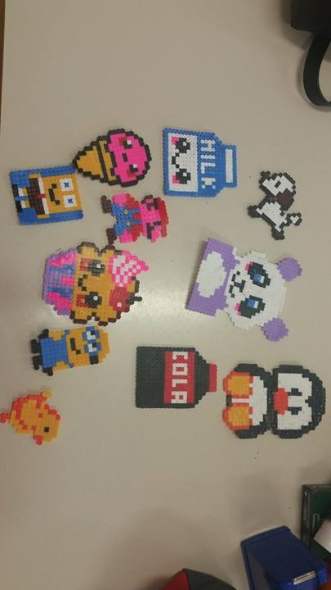
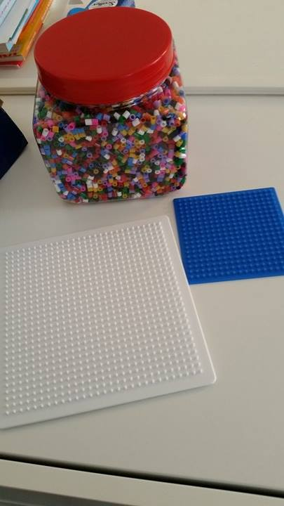
At the end children realize pixel – works enjoying themselves.

