Slide 1
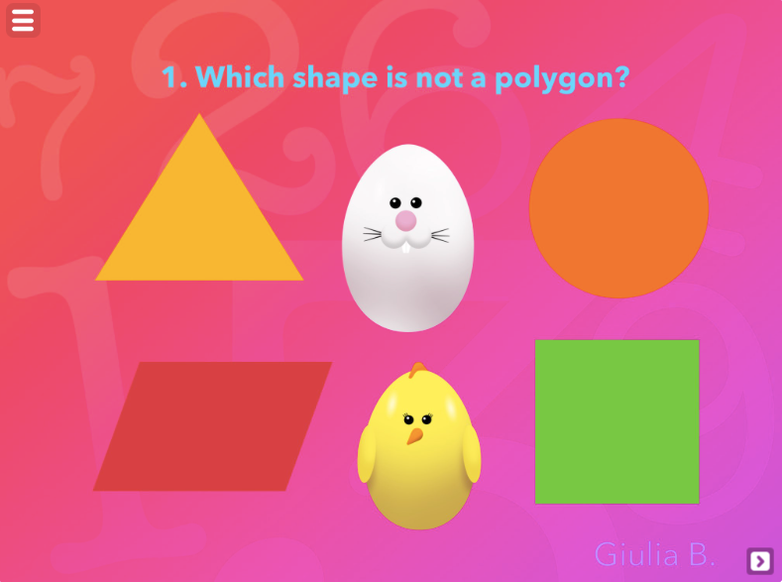
http://www.tinytap.it/activities/g25qp/play/geometry-fun-with-5a-paratico-primary-school

