Slide 1
Maths Fun Shapes
Teachers: Francesca Ministrini, Fabiana Tignonsini
A.S. 2016/2017

Slide 2
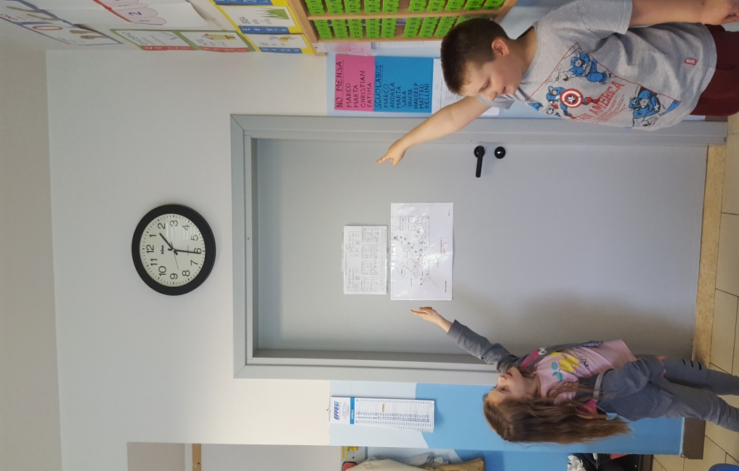
FIND IT !!!

Slide 3
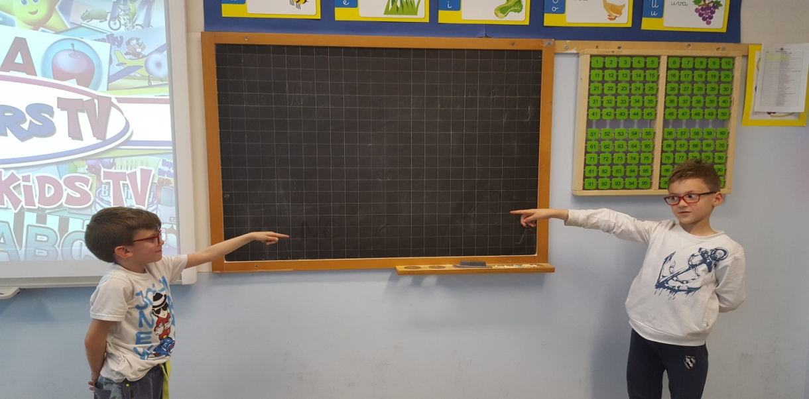
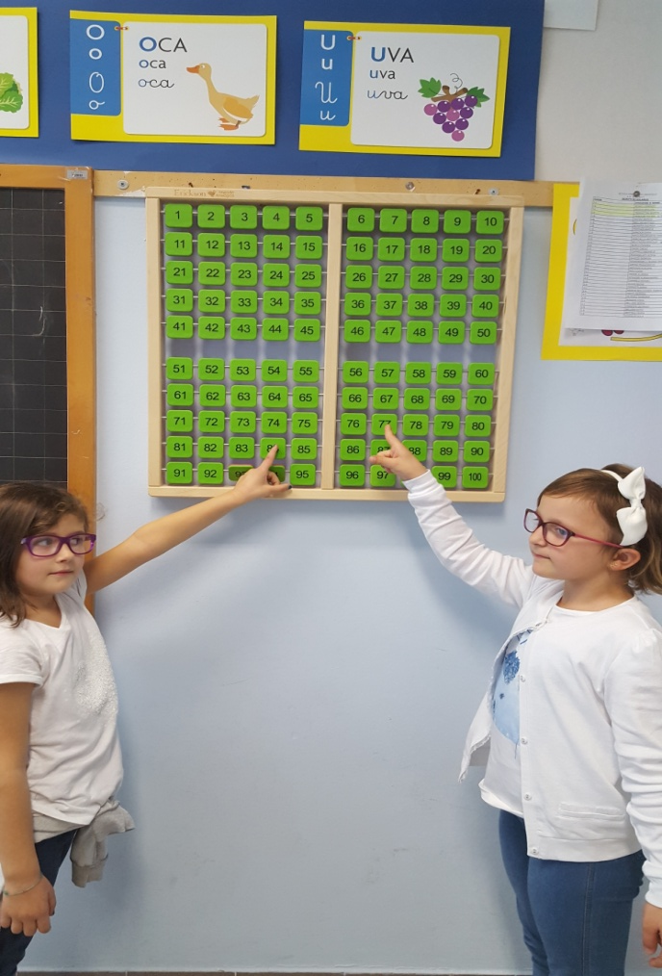
SHAPES ARE EVERYWHERE

Slide 4
WHAT CAN YOU SEE?

Slide 5
IT’S A SQUARE

Slide 6
IT’S A CIRCLE

Slide 7
IT’S A TRIANGLE

Slide 8
IT’S A RECTANGLE

Slide 9
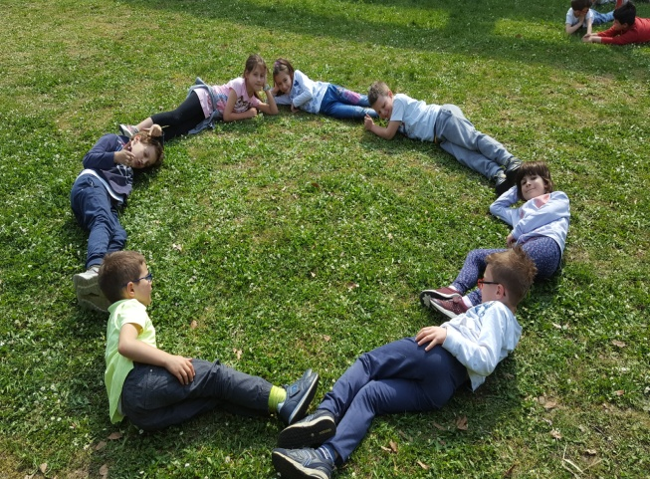
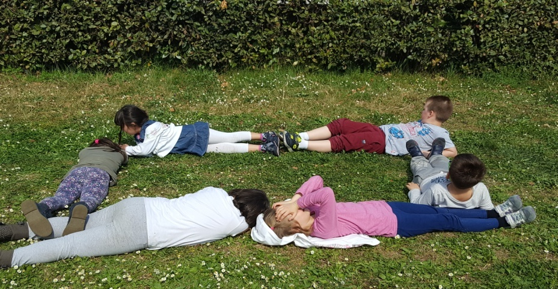
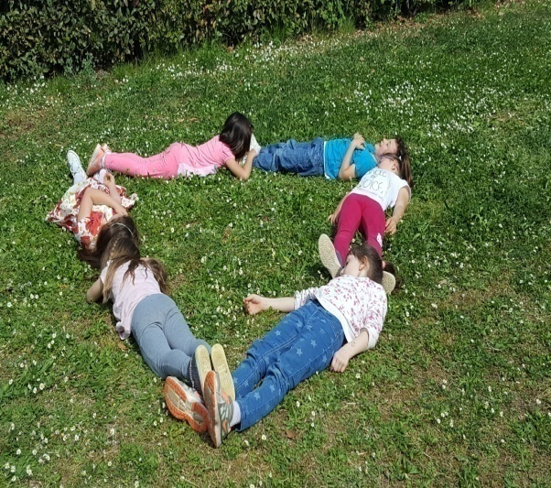
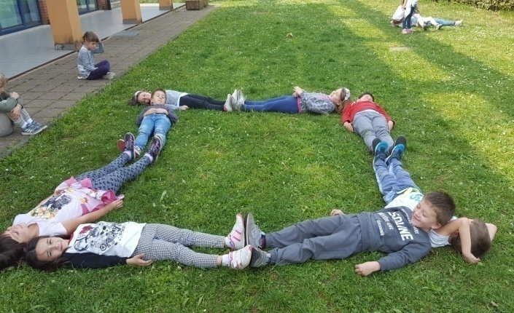
SHAPES WITH THE BODY

Slide 10
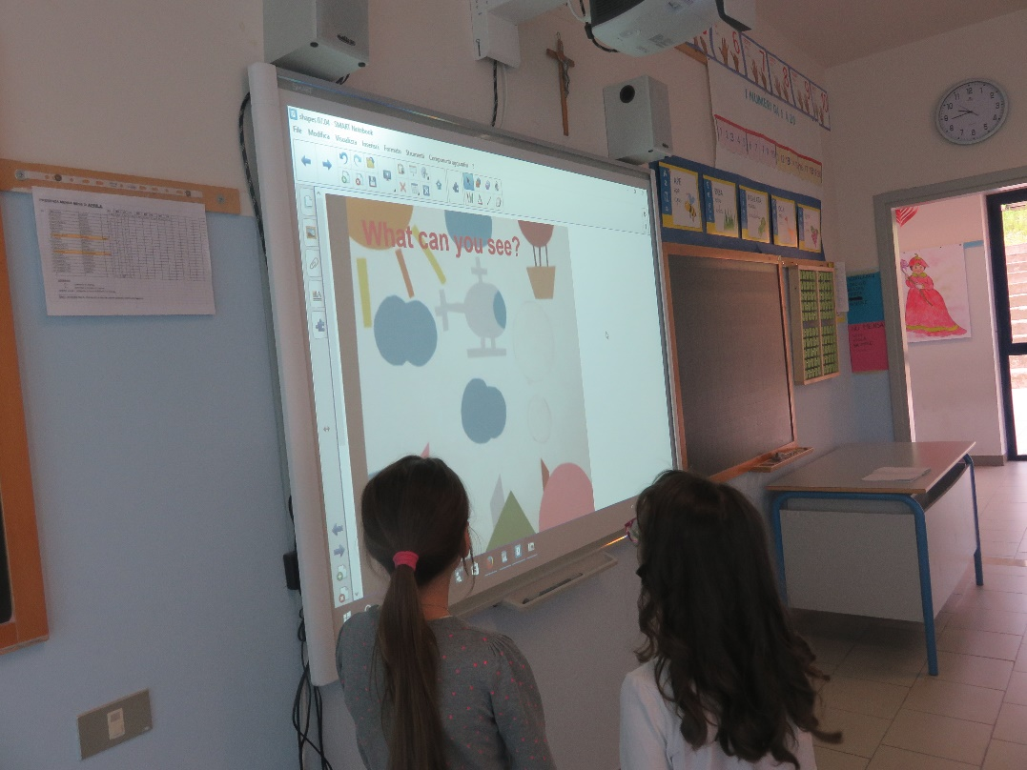
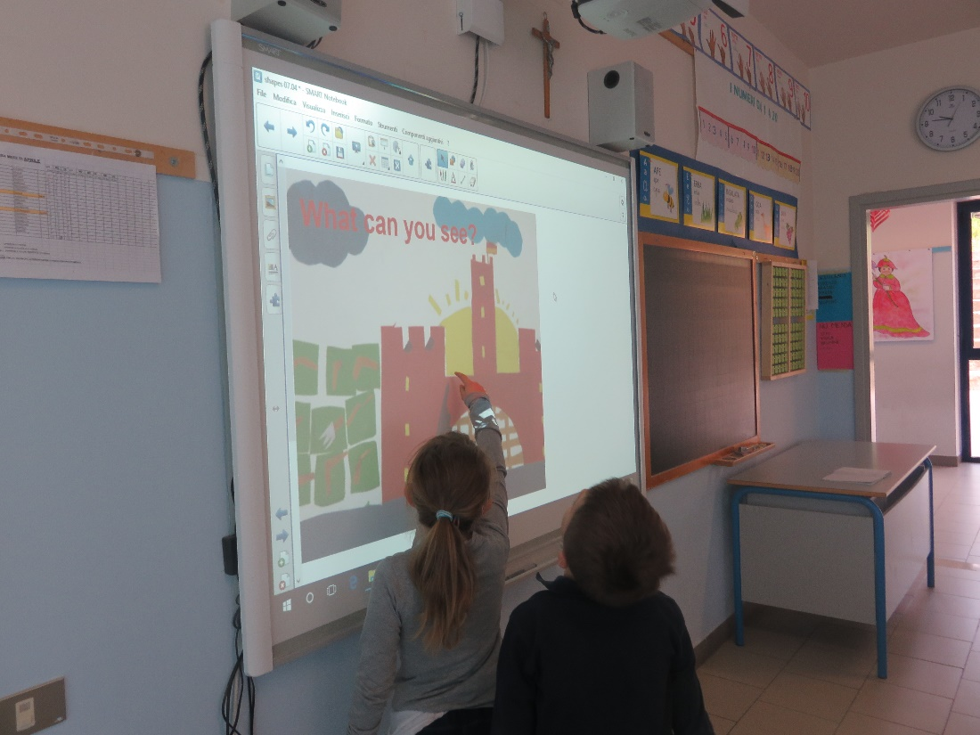
LISTEN AND FIND

Slide 11
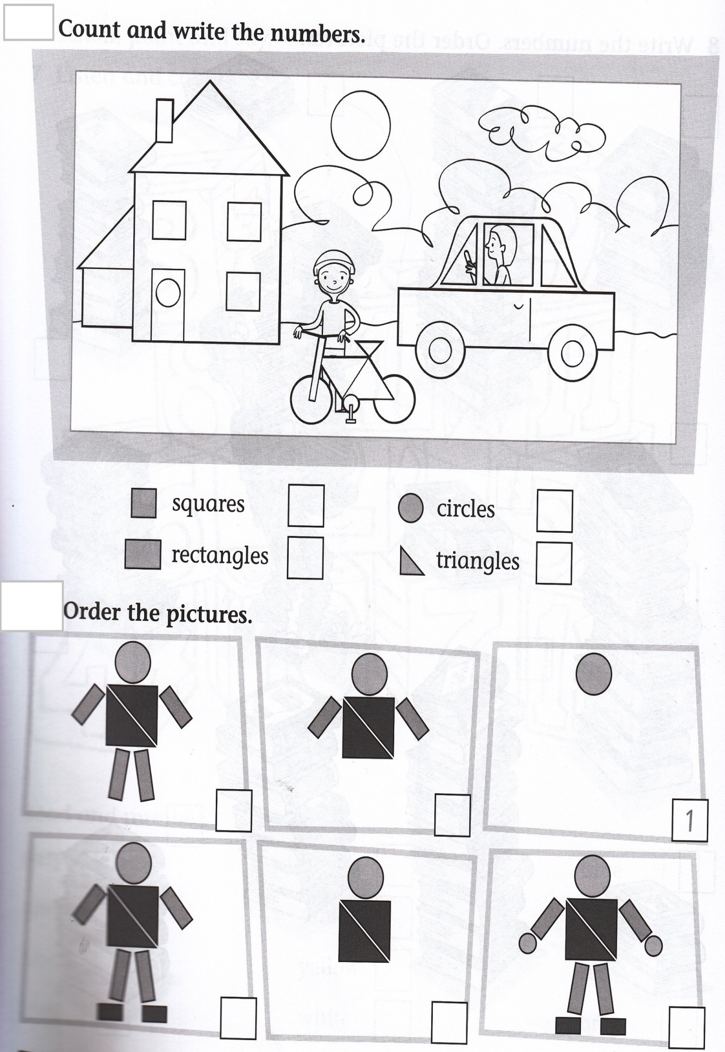
LOOK, COUNT AND WRITE. THEN SAY.
5
1 0
4
7

Slide 12
SHAPES AND COLOURS

Slide 14
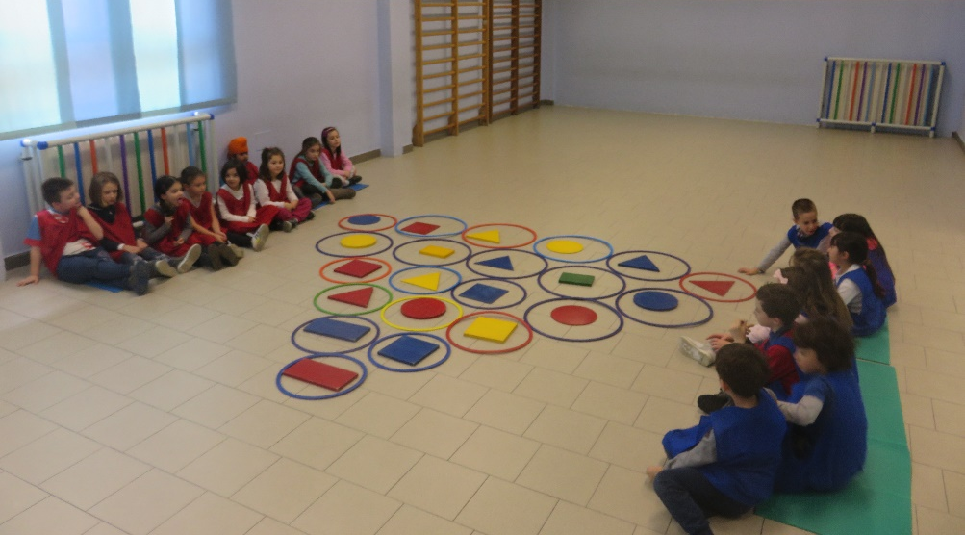
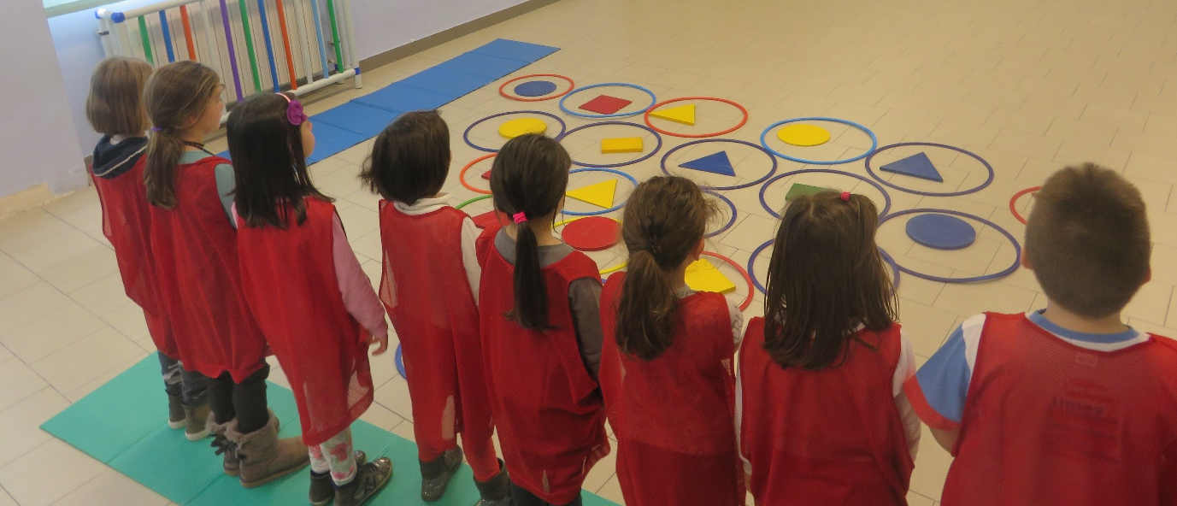
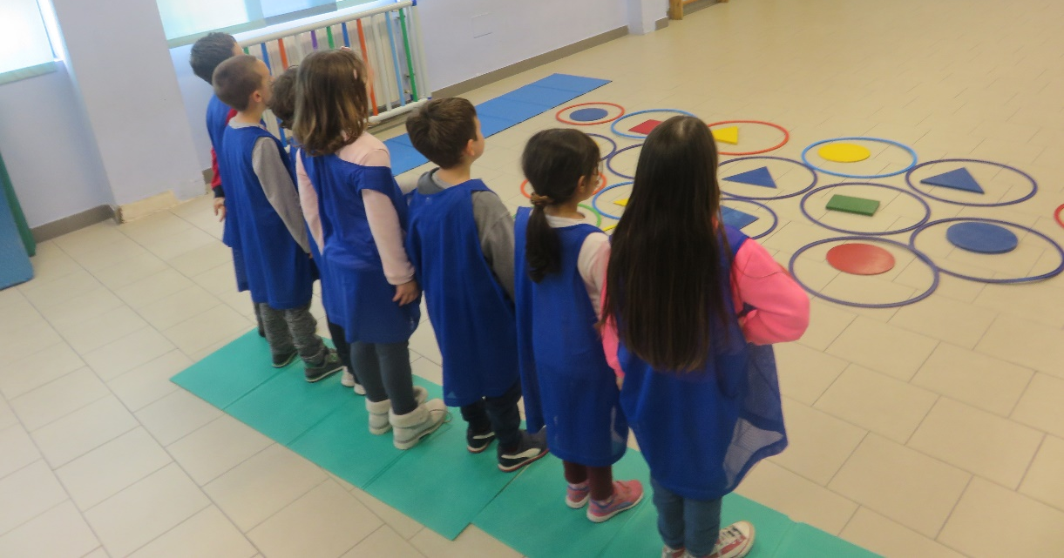
Let’s play!

Slide 15
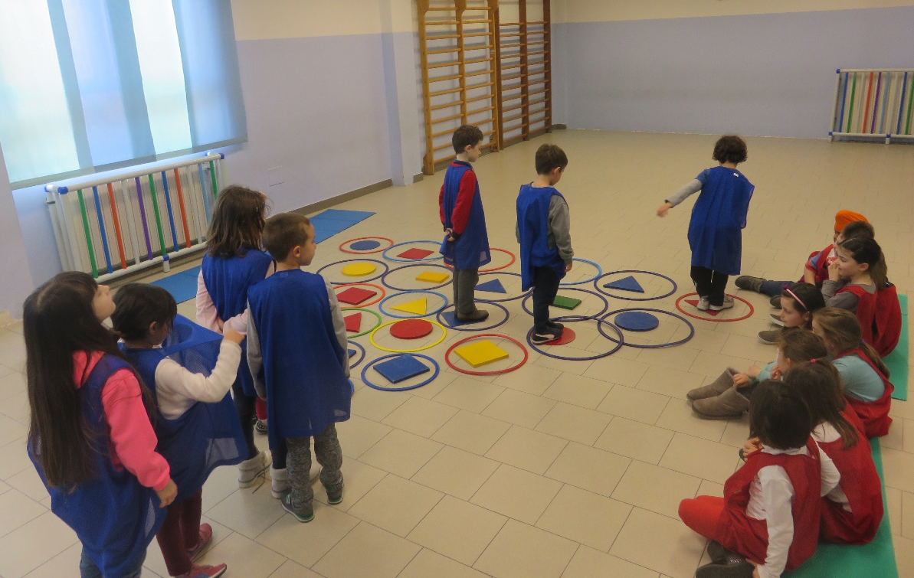
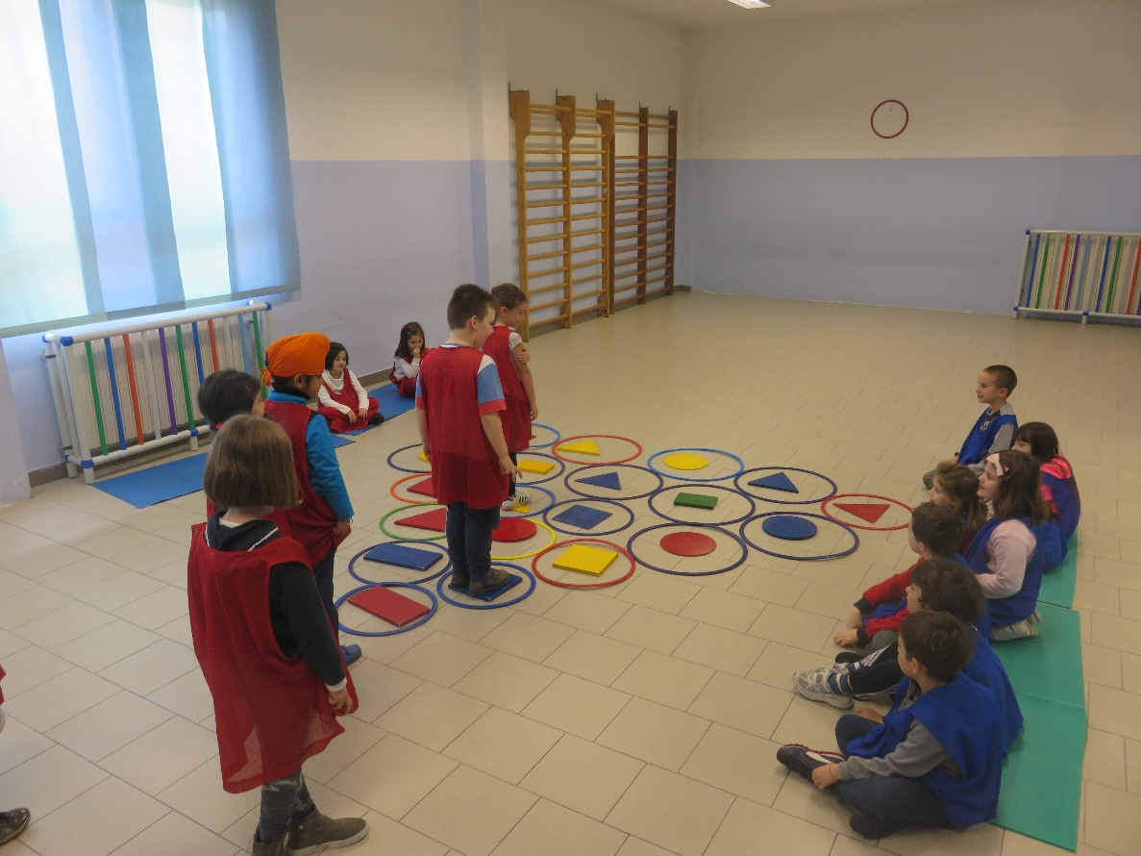
LISTEN AND FOLLOW

Slide 16
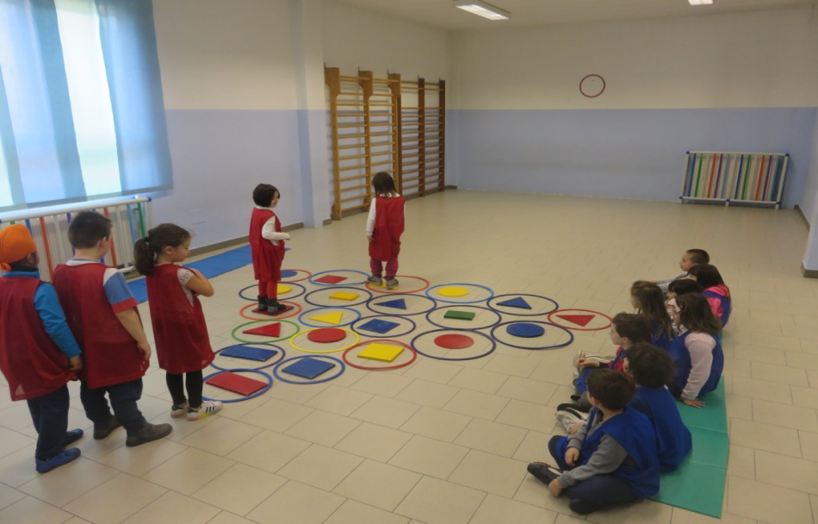
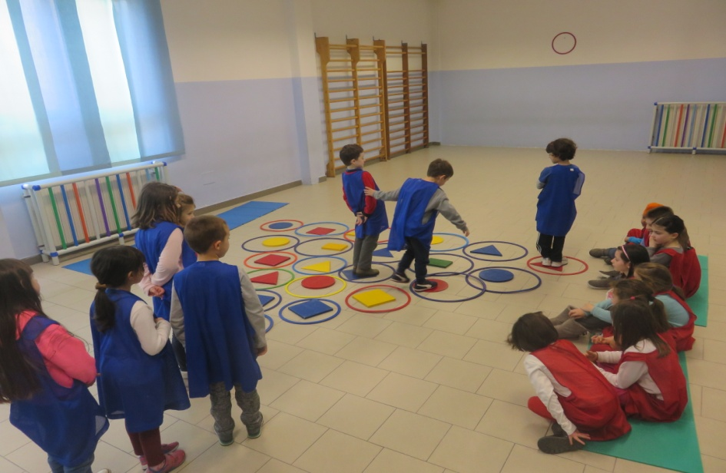
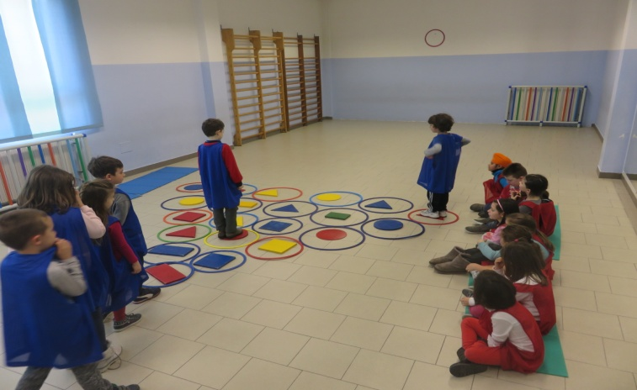

Slide 17
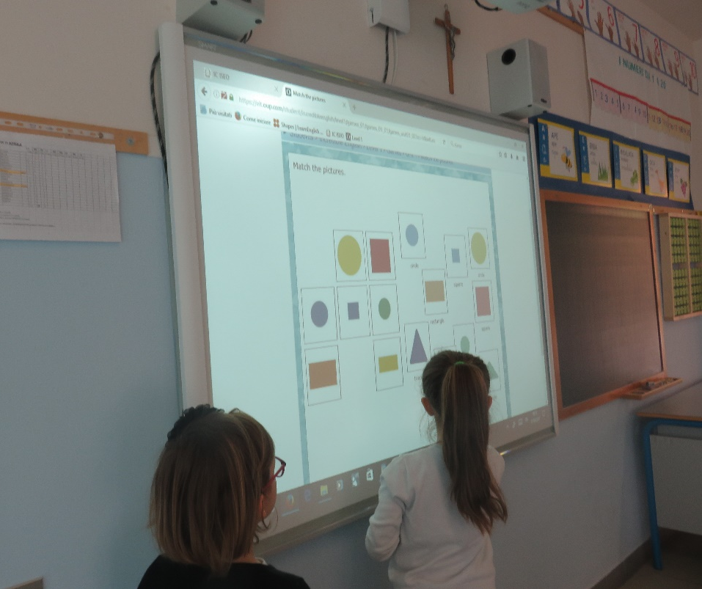
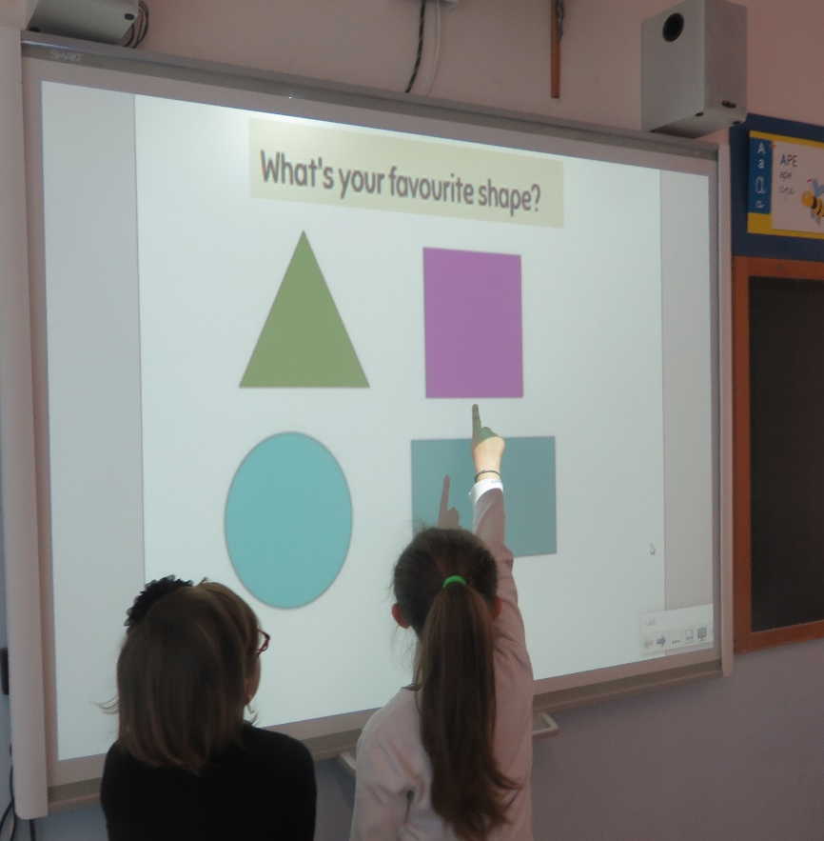
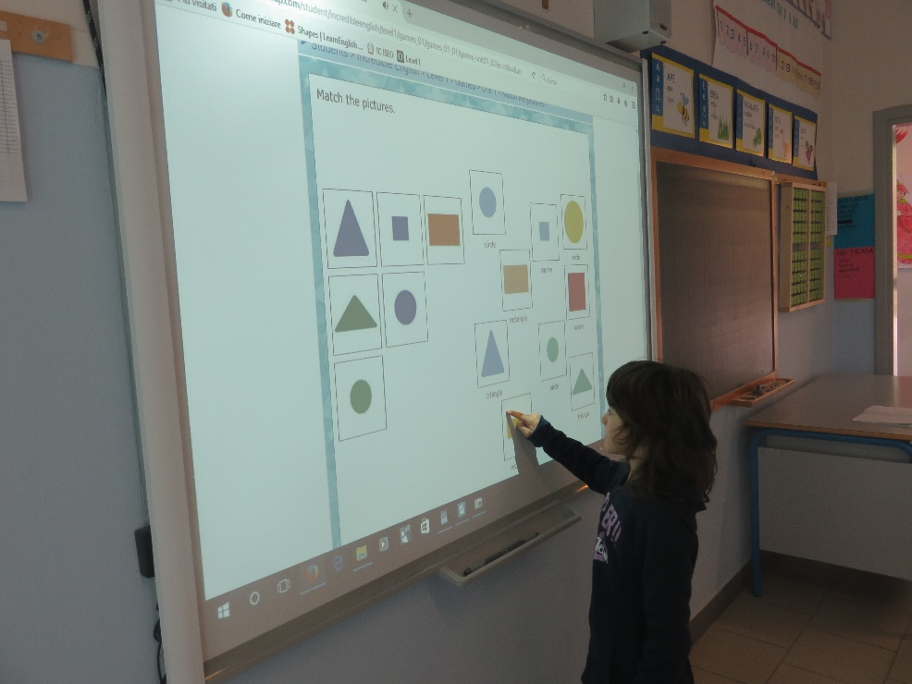
FIND AND SAY

Slide 18
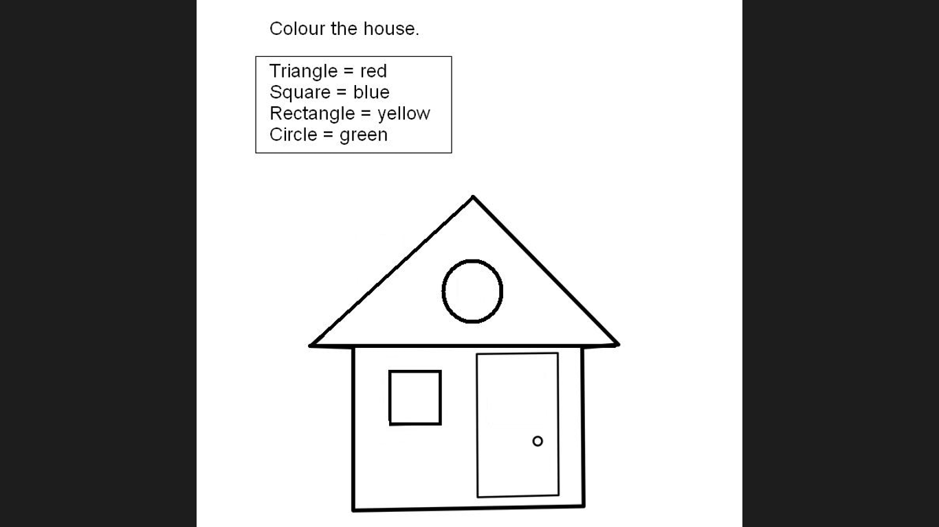
T E S T

Slide 19
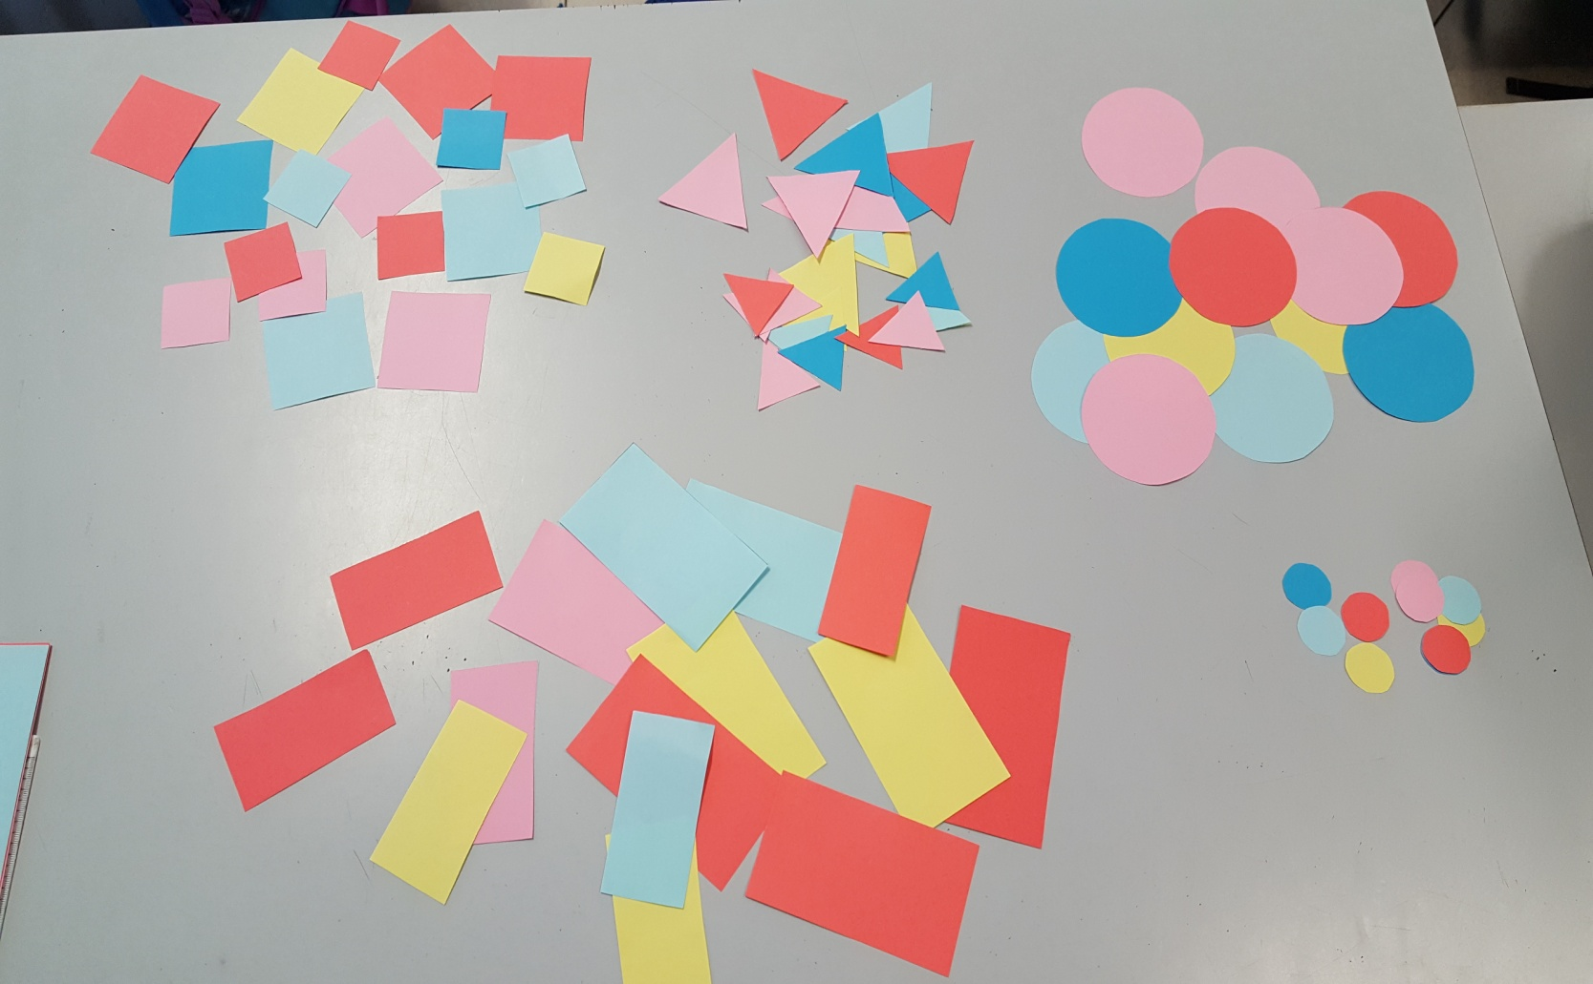
MAKE SHAPE PICTURES

Slide 20
