Slide 1
I.C. “Don Lorenzo Milani” Rovato
a.s. 2016/2017
CLIL
“ A TOURIST'S GUIDE TO BRIXIA”
Ferrari Debora - Ramera Daniele -Algar Catherine

Slide 2
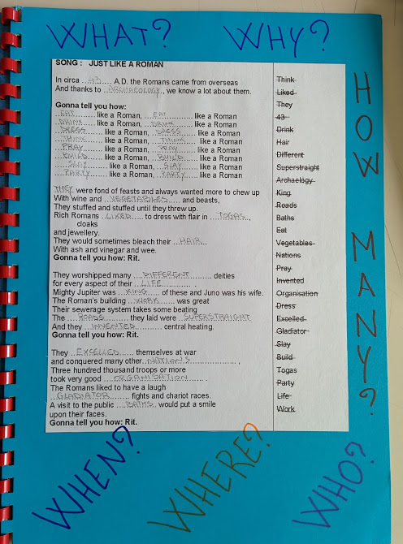
Activity one
in preparazione del video finale gli studenti studiano la canzone “Just like a roman”

Slide 3
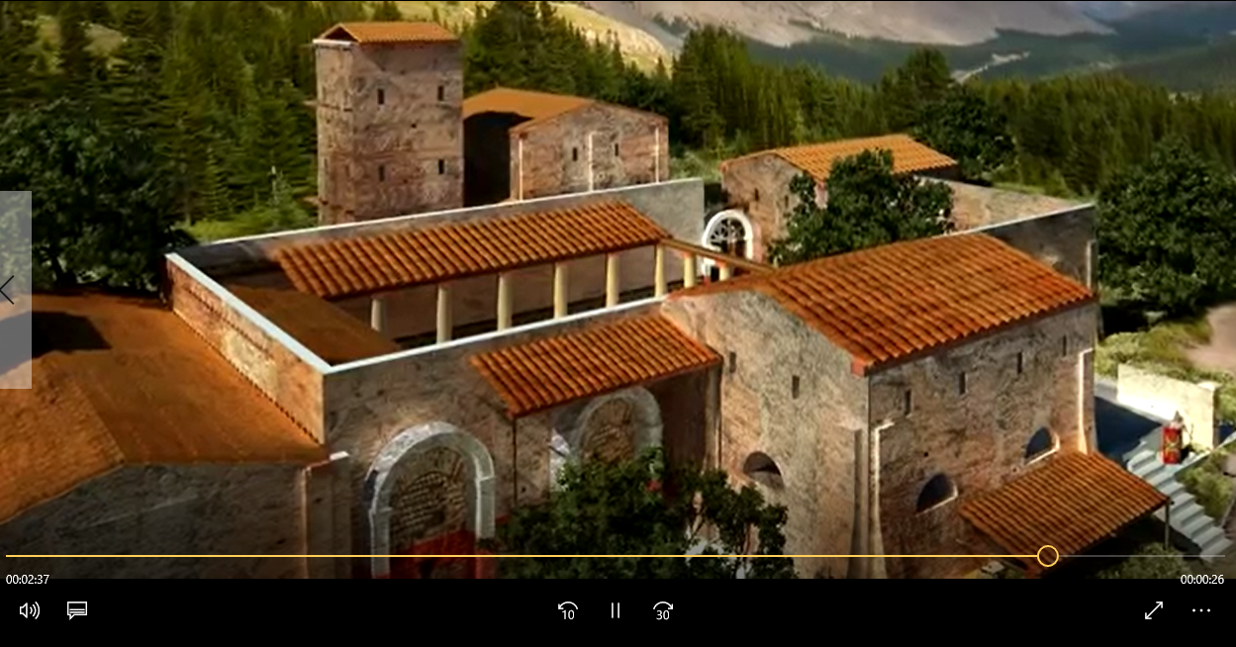
Activity three
Watch the video

Slide 4
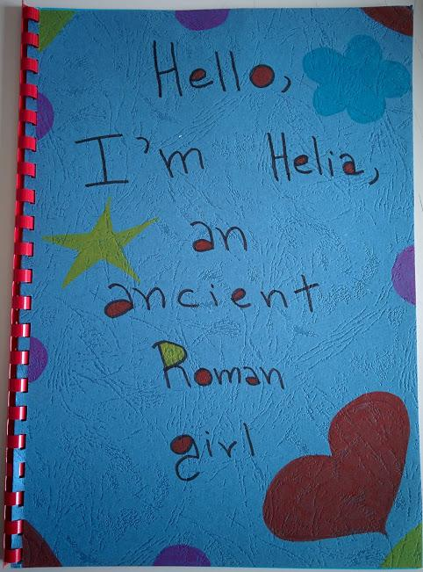
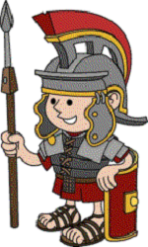
Activity two
Choose a Roman name. Gli studenti scelgono il
proprio nome romano
e pensano al loro vestito

Slide 5
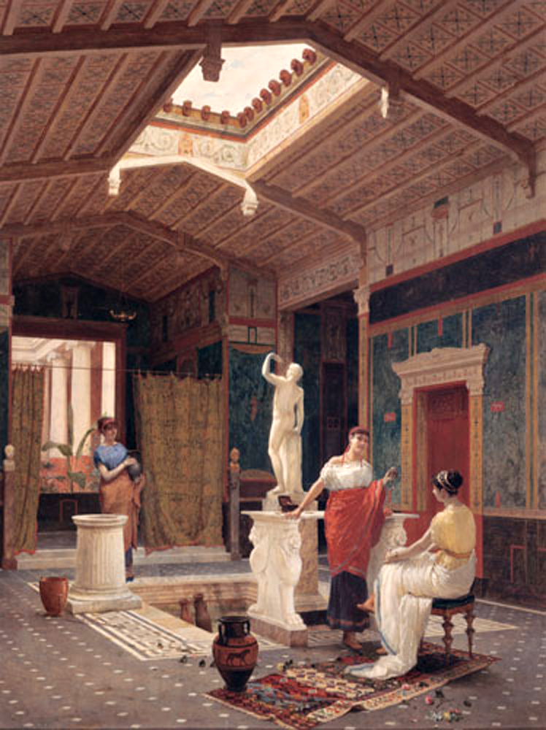
The Houses of …........ people were completely different from houses of …....... people in Roman times.

Slide 6
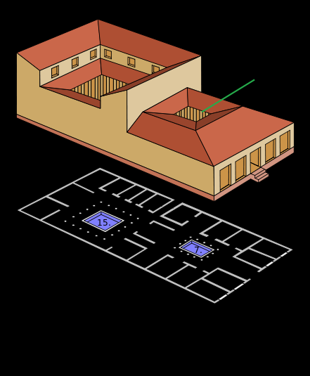

Slide 7
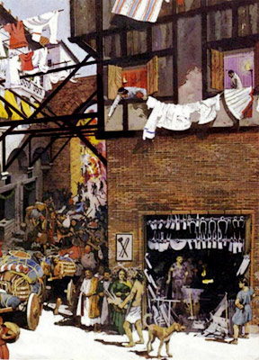
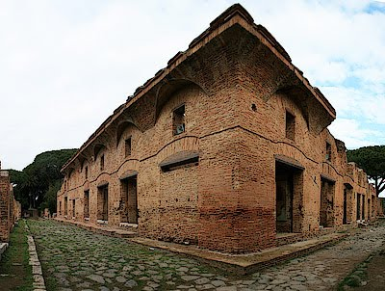
INSULAE

Slide 8
Poor Romans lived in insulae
An …........ consisted of six to eight three - storey apartment blocks, grouped around a central courtyard. In the ground floors there were shops.
Insulae were made of ….... and ….......... bricks and often collapsed or caught …........
There was no heating or running …..... and often no …...........

Slide 9
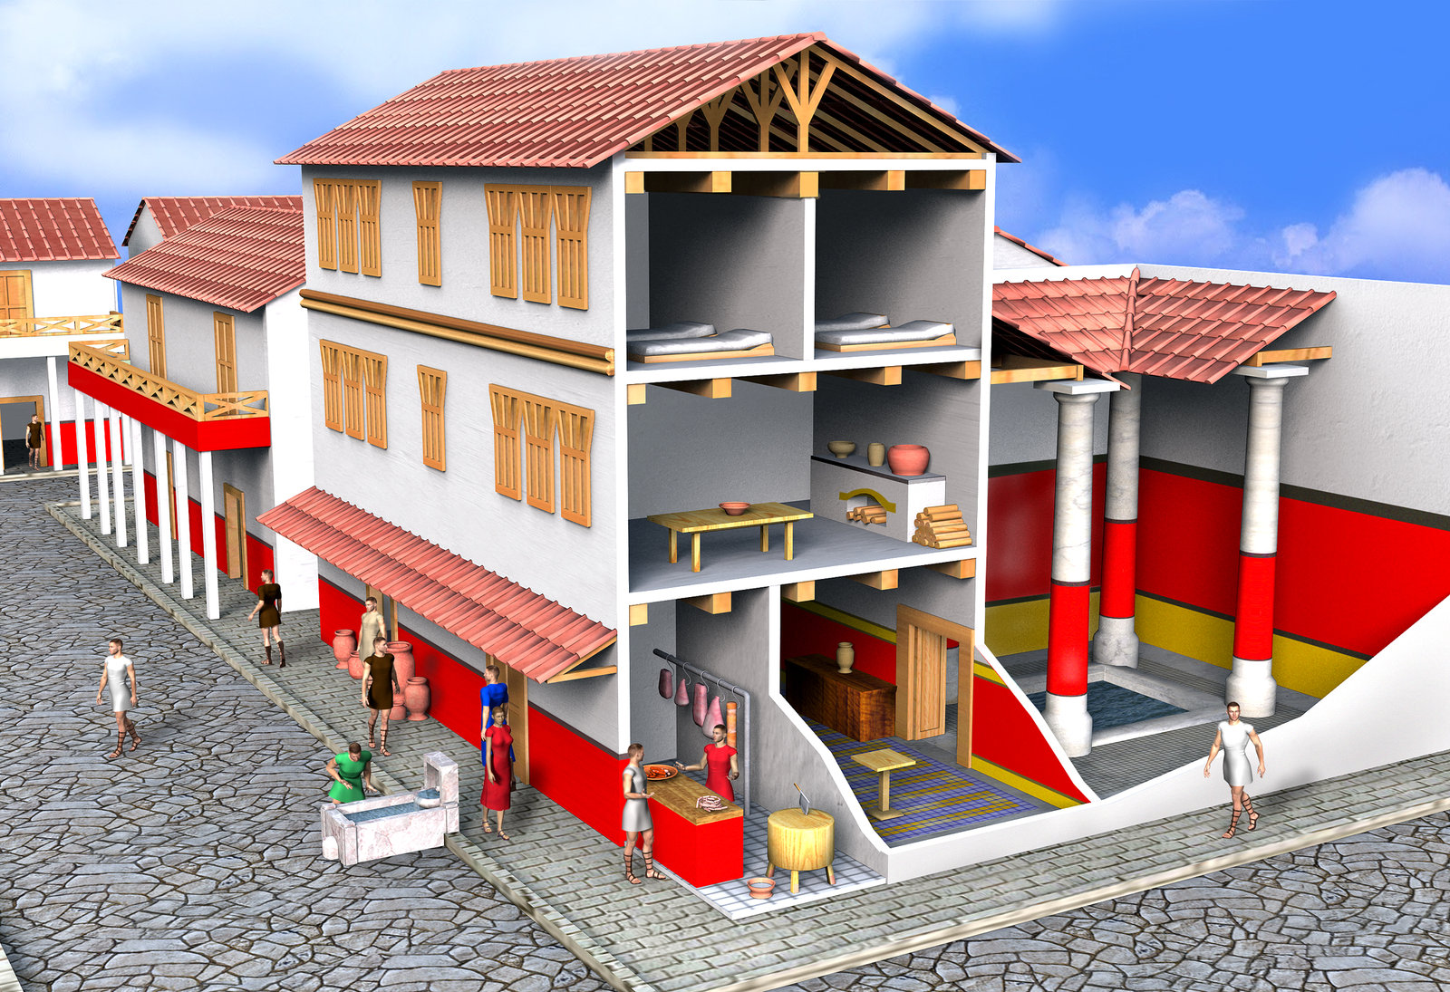
A family occupied one or two ….....
Insulae were …....., …..... and …............. places to live.

Slide 10
Rich Romans lived in a domus
One single family lived in a domus with the …...... The domus was very …...... and a …...... different rooms.
It ……. …............ with marble pillars, …............. and it had …...... on the walls and on the floors.
There was a central …....... and very often …............

Slide 11
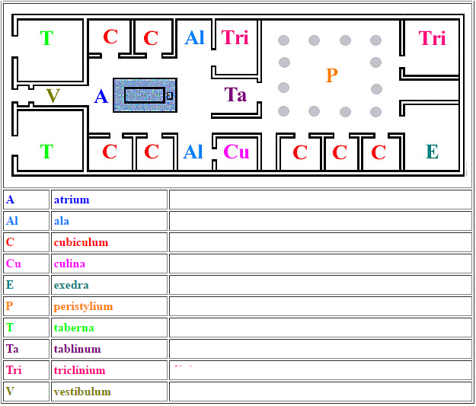
Activity three
Look at the picture

Slide 12
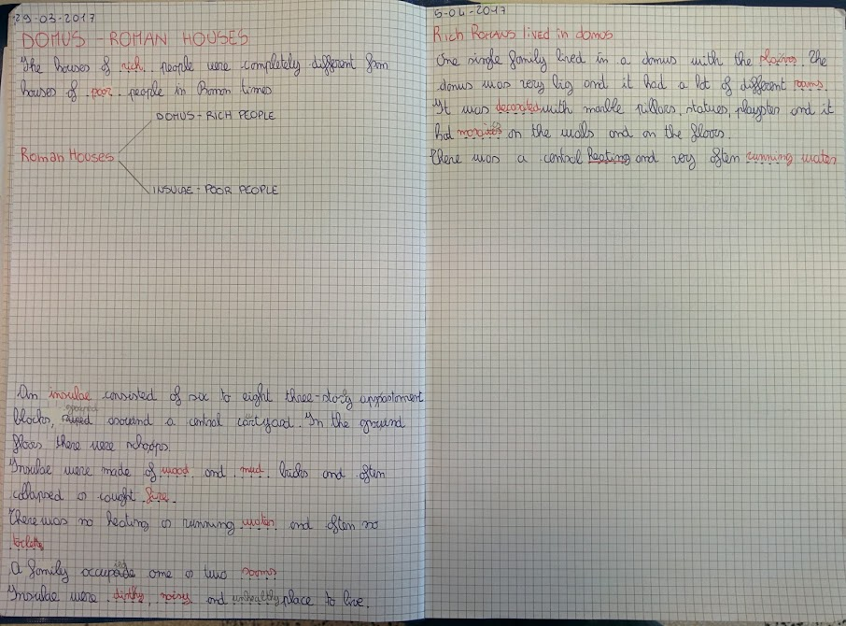

Slide 13
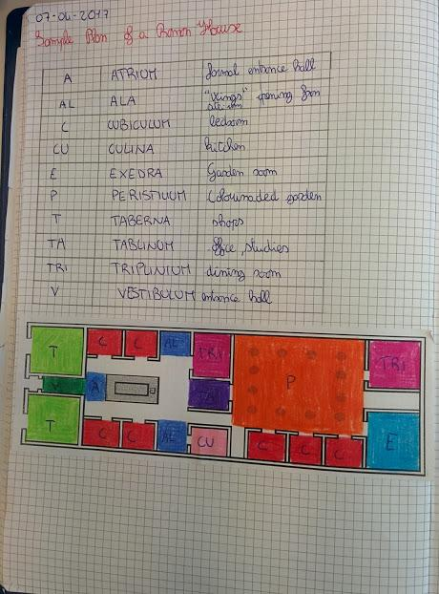

Slide 14
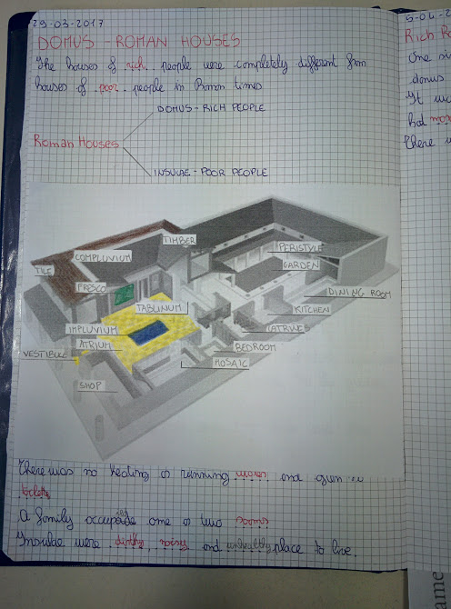
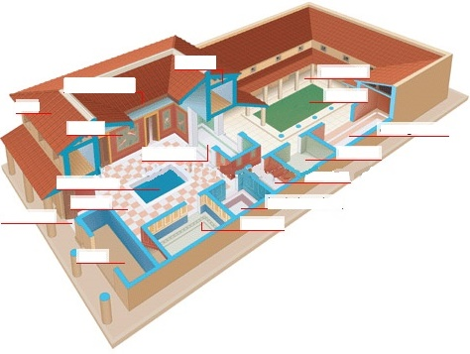
Fill in the spaces

Slide 15
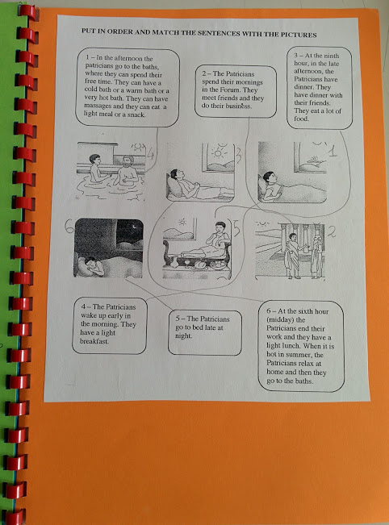
Activity four a roman day Match the activity with the right time of day.

Slide 16
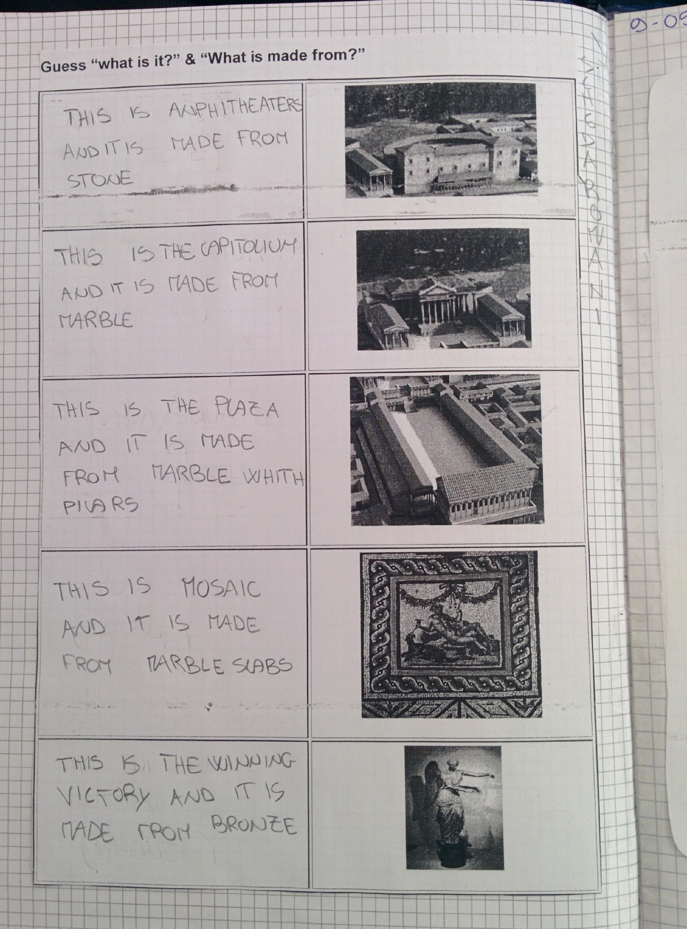
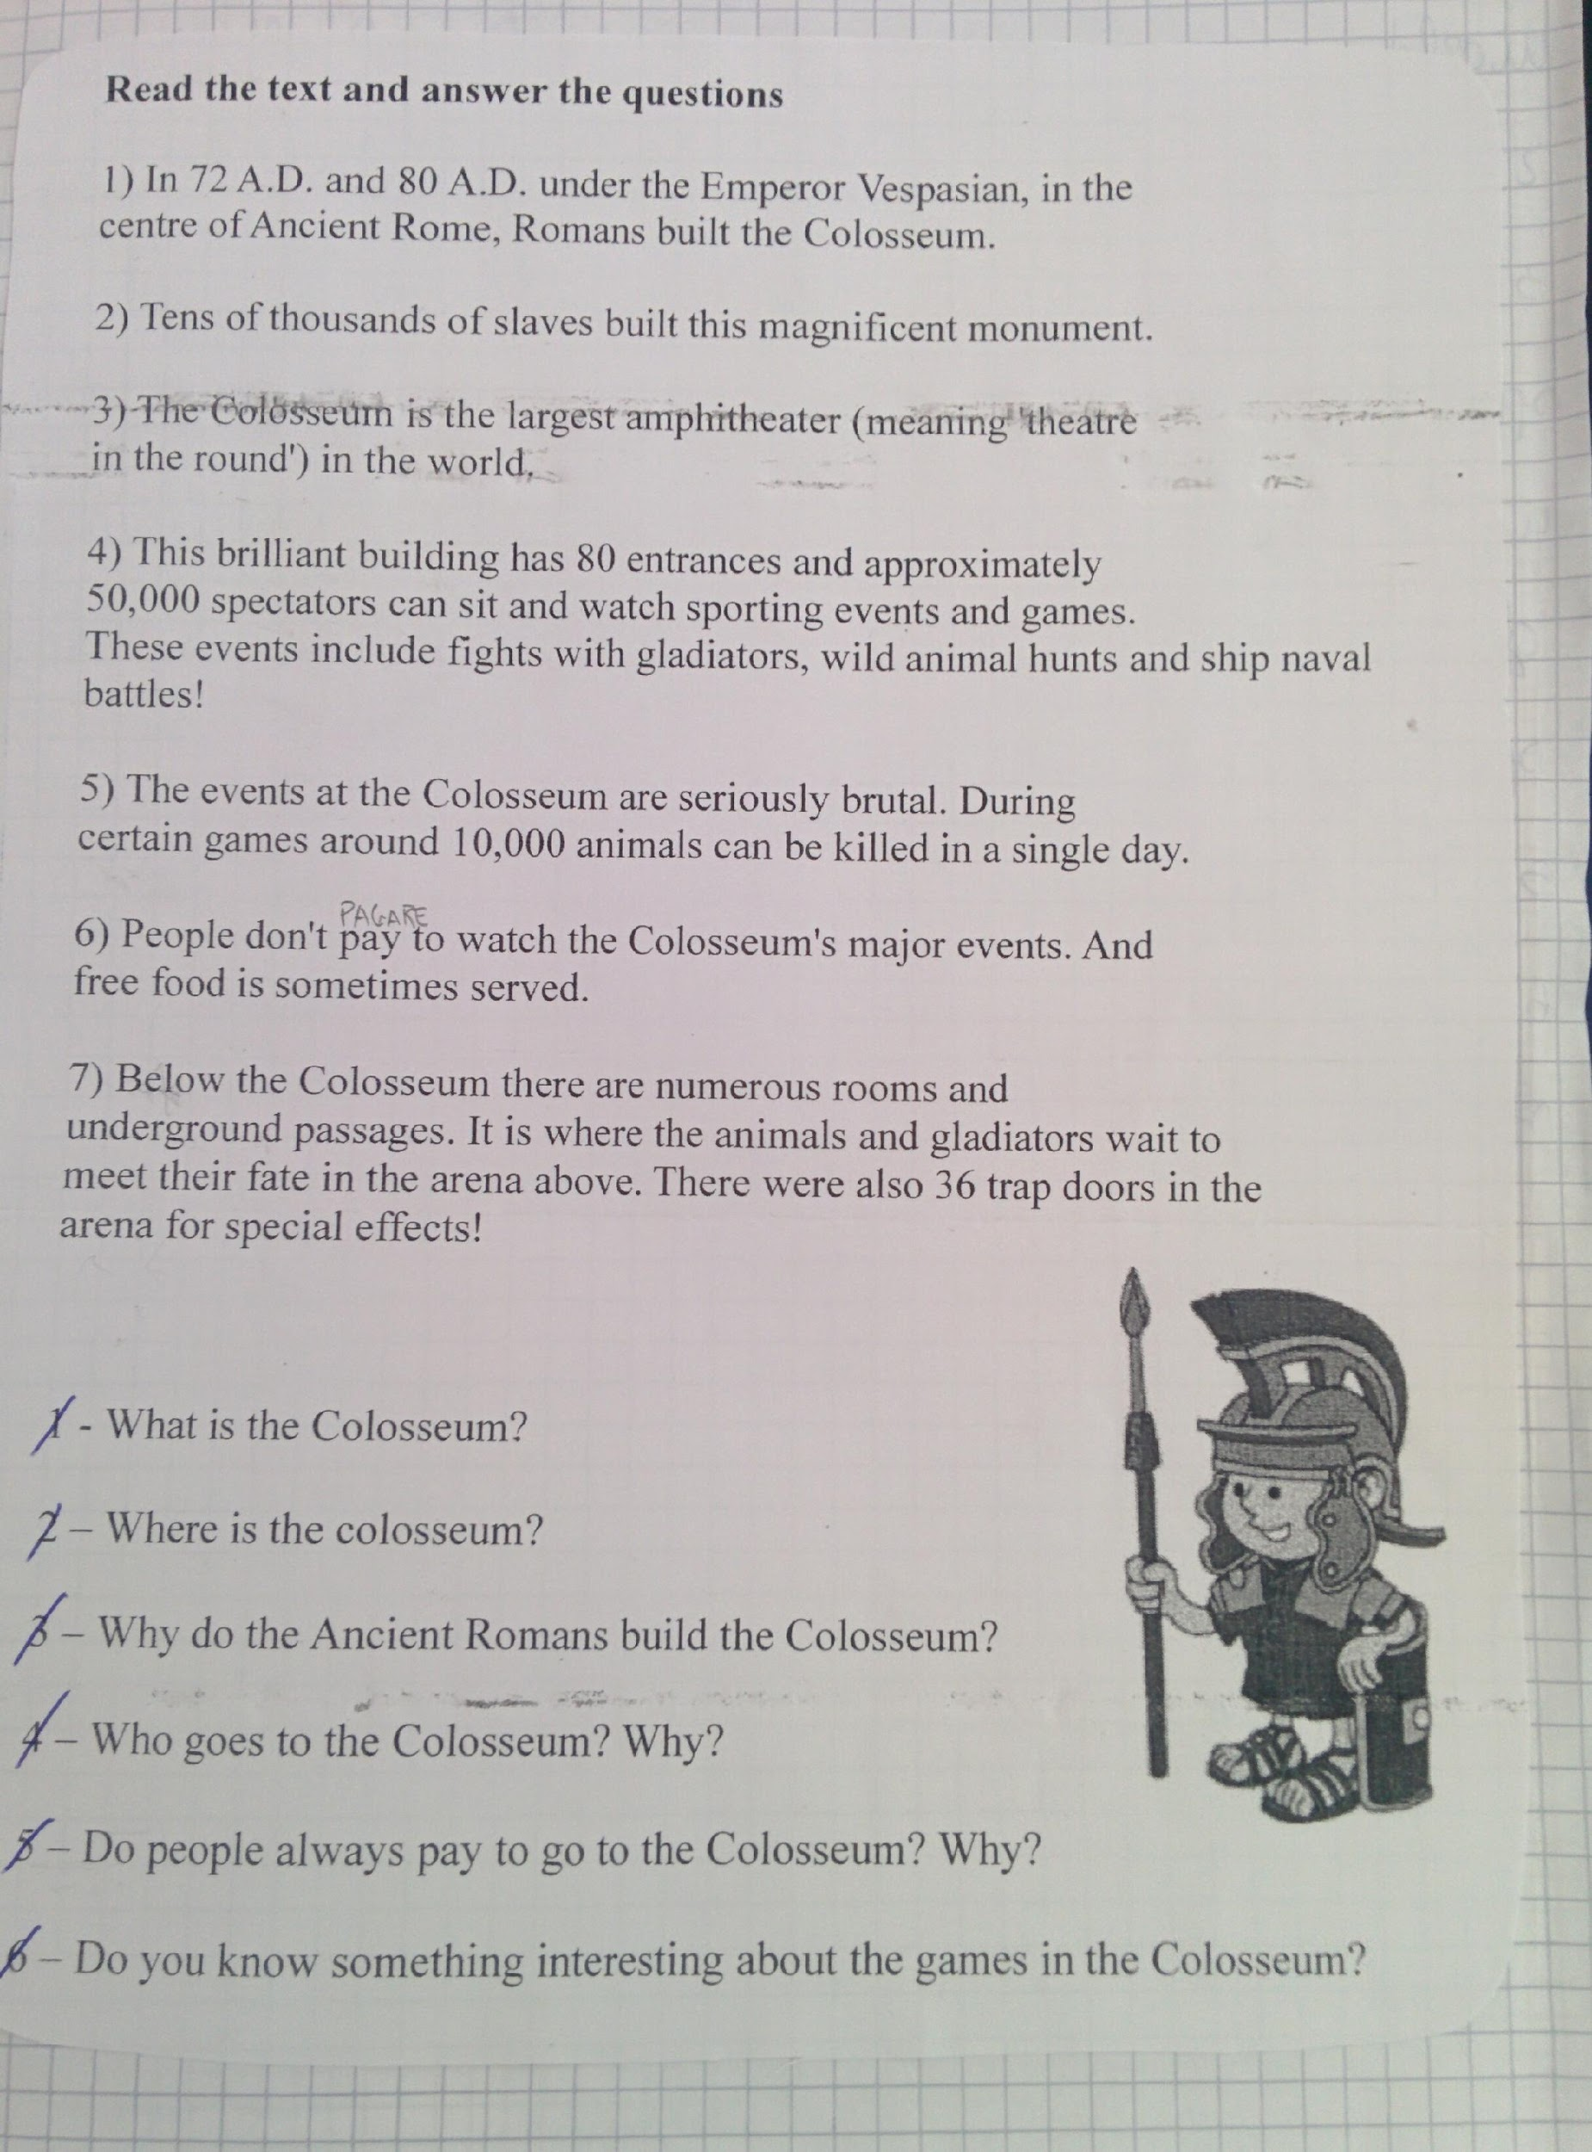
Activity five Roman arts & Architecture
Listening, reading and comprehension
Guess “what is it?”
“What is it made from?”

Slide 17
BRIXIA – THE ARCHEOLOGICAL AREA OF ROMAN BRESCIA
The city centre contains the monumental remains of ancient Brixia.
This area had long been abandoned, but was rediscovered in the early nineteenth century and may now be admired in its original splendour.
THE CAPITOLIUM
The Capitolium, at the centre of a terraced sanctuary, was dedicated to the cult of the Capitoline Triad, within its chambers the original features may still be seen: flooring in coloured marble slabs, altars in Botticino limestone and fragments of magnificent cult statues.

Slide 18
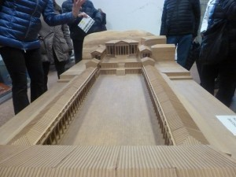
Model of Brixia
Forum

Slide 19
Characteristics
ARCH & VAULT:
Colosseum
Race Track – Circus Maximus
Public Baths
Amphitheaters

Slide 20
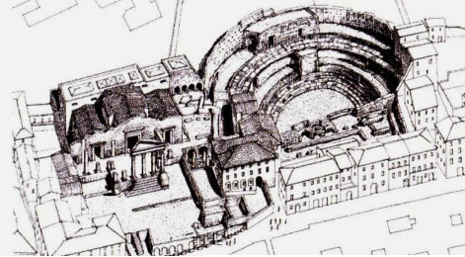
Visitors enter the cavea – a spacious area that rests in part of the slope of Cidneo Hill – where spectators once sat ,bringing to mind ancient performances

Slide 21
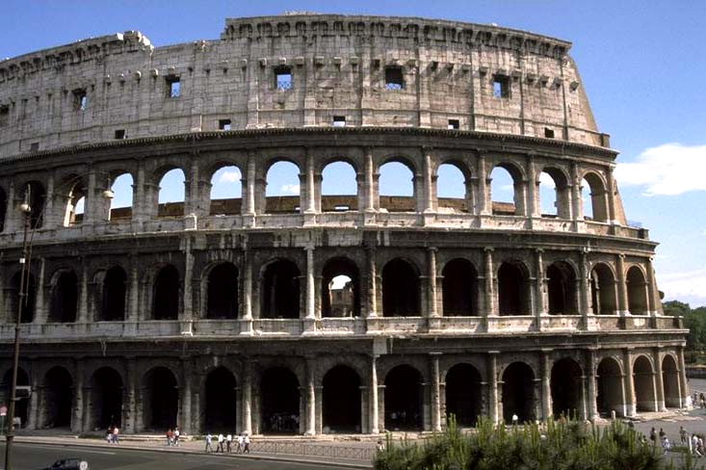
Roman Colosseum

Slide 22
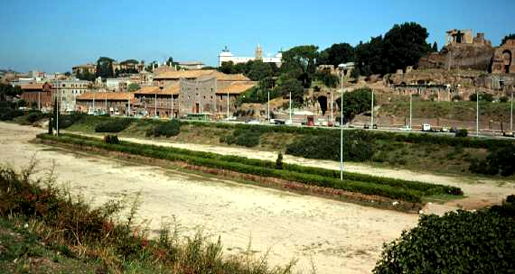
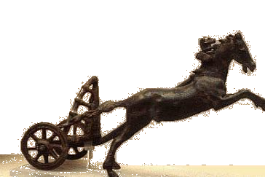
Circus Maximus
300,000 seat capacity!

Slide 23
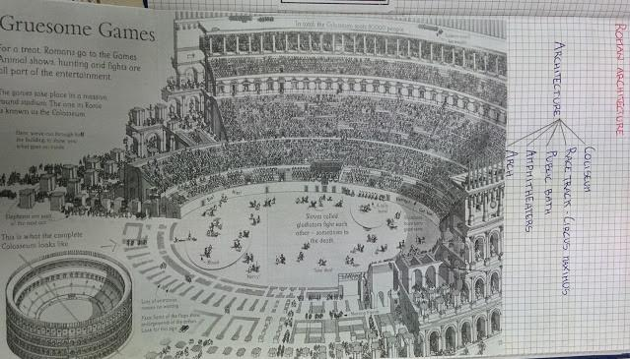

Slide 24
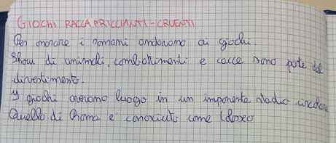

Slide 27
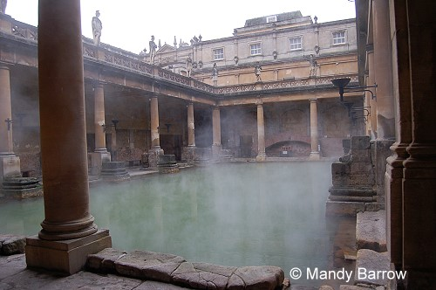
Activity six Catherine tells us about the Roman Baths in the UK.

Slide 28
10 fun facts about the Roman Baths in Bath!
Hot
Temple
Money
With mosaics
In 70AD
Invaded
Of 46 degrees
Swimming
With mirrors
Name
It was built in……shortly after the Romans…….Britain
The water has a temperature of…
The walls were decorated with…
The floors were decorated with…
Inside there is a…dedicated to the goddess Sulis Minerva
The Romans gave the…of Aquae Sulis to this town
Each Roman town has a bath complex, like a…pool
The hypocaust was a heating system so there was always…water
You can find lots of gold Roman…dedicated to the goddess

Slide 29
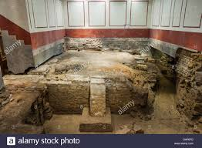
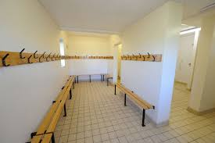
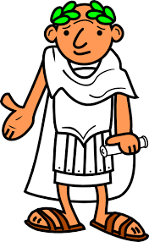
This is where I get
changed to have a bath

Slide 30
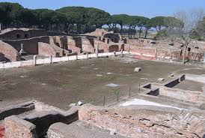
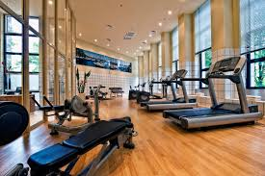
I come here to do some exercise
(I often get very sweaty!)
The palestra

Slide 31
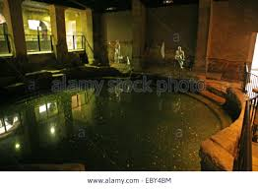
Then I come to the tepidarium,
which is a big warm bath
The tepidarium

Slide 32
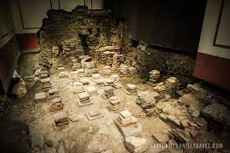
This the caldarium,
a very hot bath.
The caldarium

Slide 33
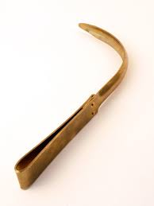
This object is called “strigil”.
A slave puts oil on me and then with
the strigil, removes all the oil and dirt.

Slide 34
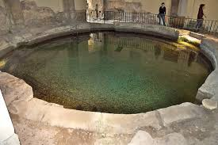
Then I come back to the tepidarium
(a warm bath) and
after I go to the frigidarium
(very cold!)
Tepidarium and frigidarium

Slide 35
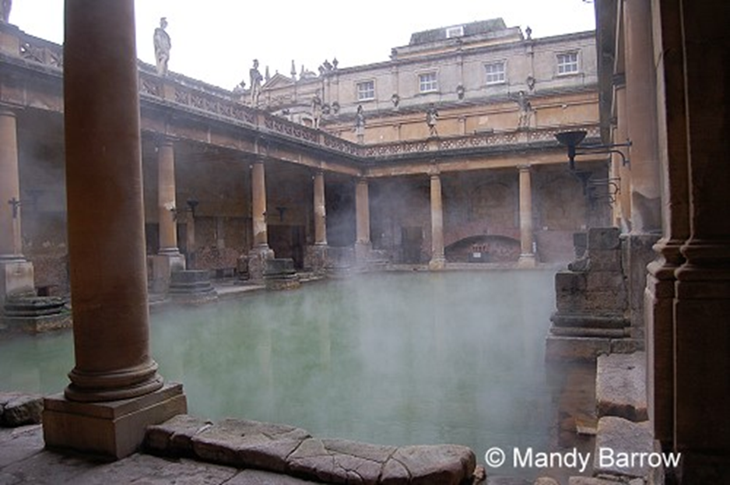
The main pool
Finally, I go to the
main
pool for a
swim and to talk
to my friends

Slide 36
Activity seven
Test & evaluation.

Slide 37
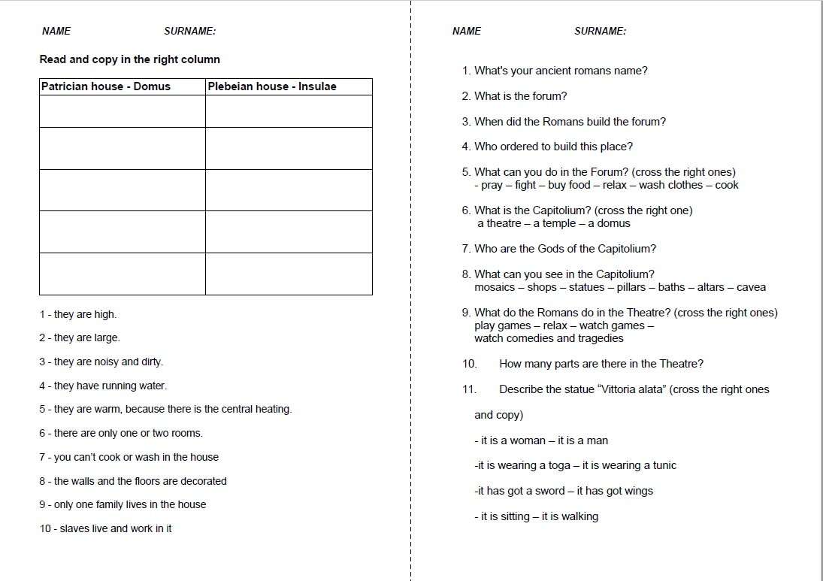

Slide 38
Activity eight LIGHTS CAMERA ACTION

