Slide 1
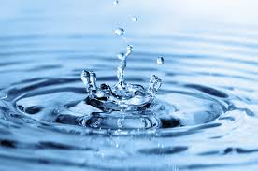
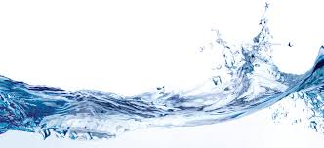
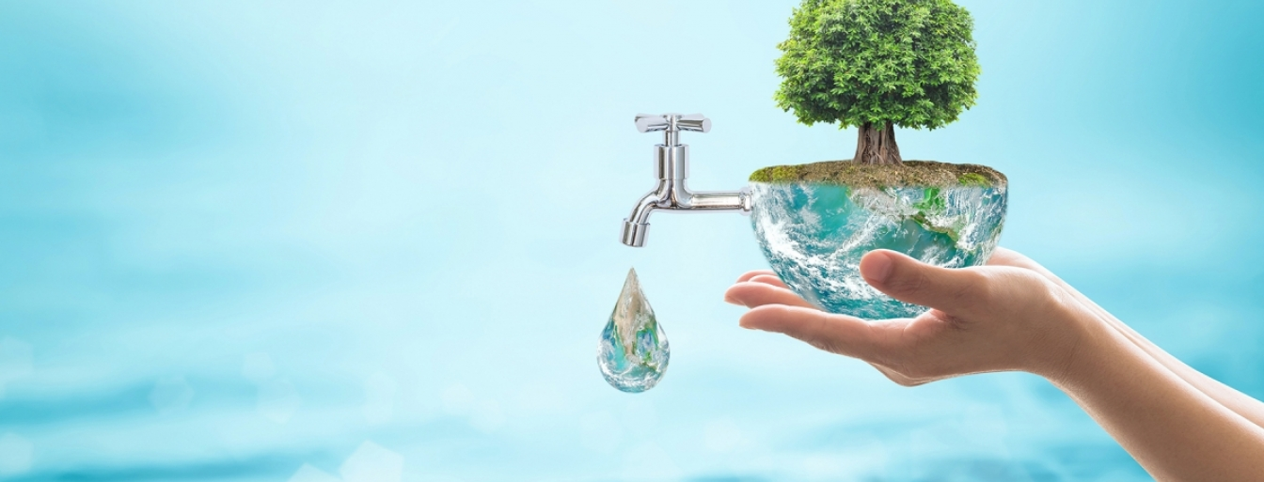
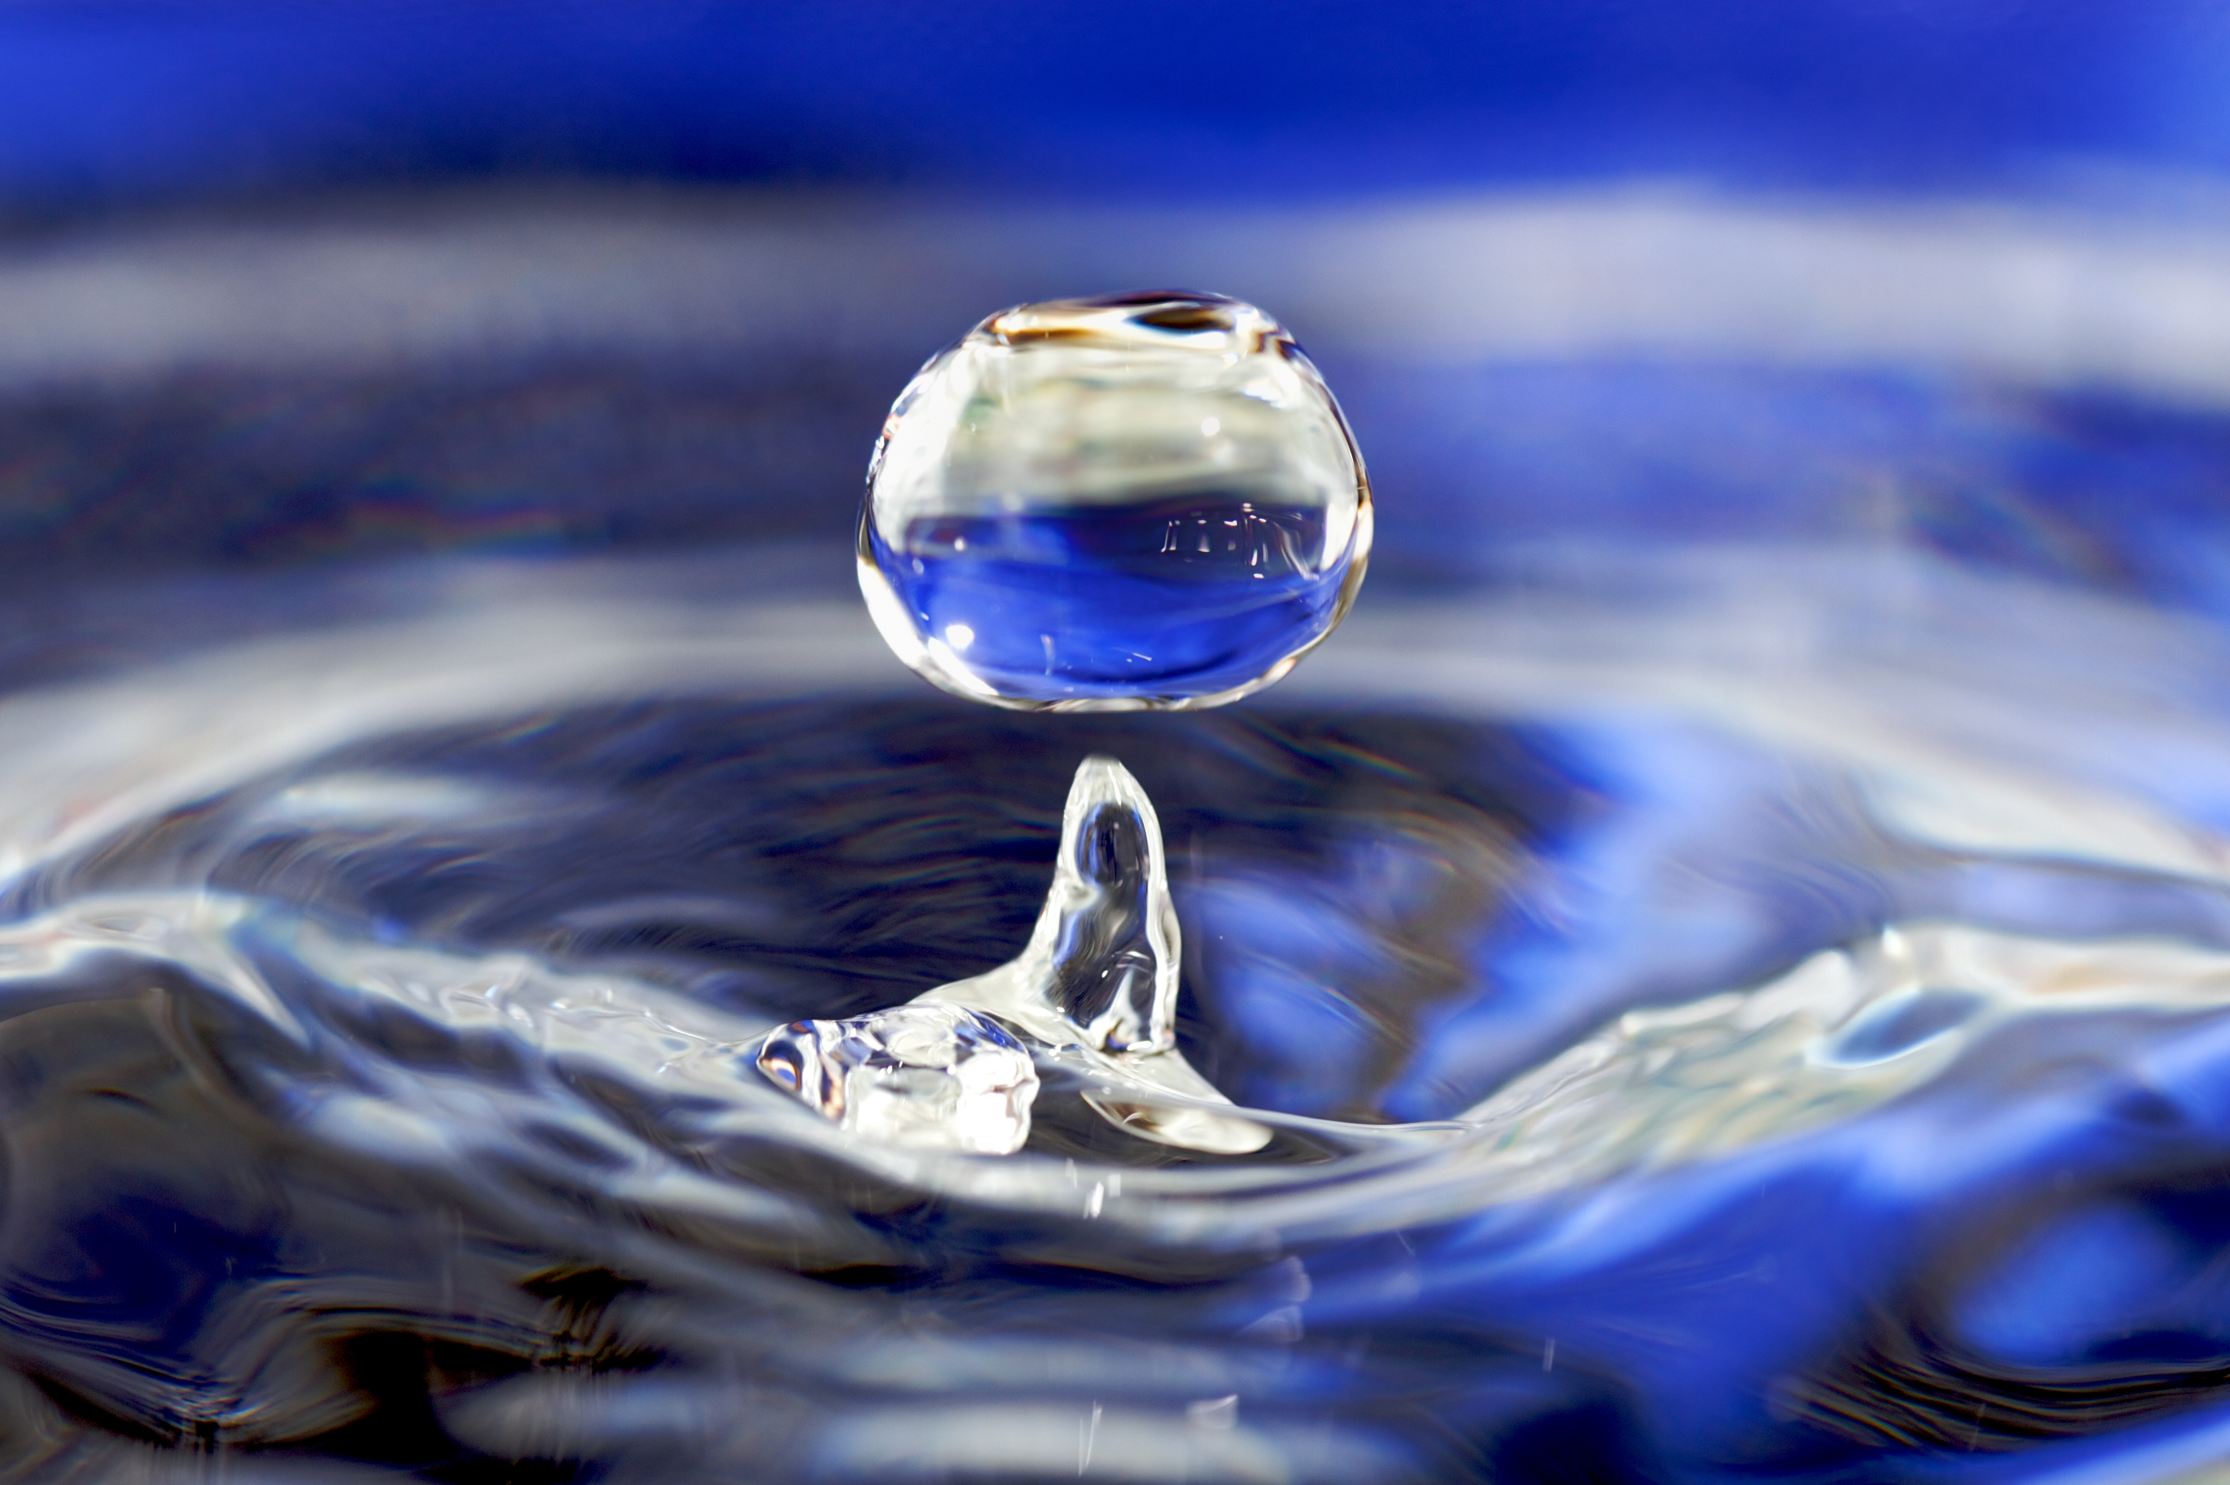
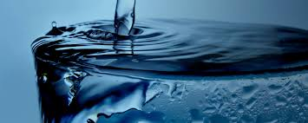
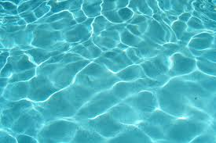
Water:
How we can save it?

Slide 2
Produce Energy
Drink
Grow Plants
Wash hand
and face
Have a Shower
Wash Vegetables and Fruit
Wash the Car
Activities with Water
Wash Pets
Wash Clothes
Make Clothes
Water the Plants
Go swimming
Cook
Brush Teeth
Use the Dishwasher and the Washing Machines

Slide 3
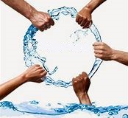
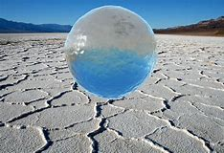
The war for the water
The review was presented at the Fourth World Water Forum in Mexico, which ended on 22nd March, World Water Day.
The balance between demand and availability caused periods of drought and low rainfall.
To mark the international observance of World Water Day on 22nd March, the Commission's Joint Research Centre (JRC) has published a new report entitled 'climate change and the European water dimension’.
The Commission published its first implementation report for the Water Framework Directive on 22nd March 2007, World Water Day.

Slide 4
Lala’s story
One of the young girls who everyday walks miles for a tank of water
Lala was a 11 years-old girl form the Soavinarivo Village in Madagascar, she walks twice a day to take water everyday from the age of 4 years.
Everyday Lala walks for 4 Miles twice a day to get some un-clean water, at each miles she thinks:
First Mile – “At one mile I wish my day could start like yours, a walk to go school and later
go to a shopping mall or to a party or to the local park”
Second Mile – “At two miles I start thinking about your luck, you turn on a tap and a flow of
water starts running and you use it to clean teeth, have a shower or drink”
Third Mile – “At three miles I think you can go to the pool to swim and use more water than we
imagine”
Fouth Mile – “At four miles I think about when you will reason on our situation and you will
understand that water is a precious resource and should not be wasted or
will end”

Slide 5
We use water to… | When there isn’t any water, people…
Grow food | Can’t wash their hands
Cook | Can’t go to school
Make energy | Walk many km every day to look for water
Flush the toilet | Don’t have toilets
Brush your teeth | Die from diarrhoea
Did you know?
1.Washing the car (1,892 Litres)
2.Having a bath (189 Litres)
3.Watering the garden (76 Litres)
4.Eating a hamburger (57 Litres)
5.Washing clothes (38 Litres)
6.Brushing the teeth (11 Litres)

Slide 6
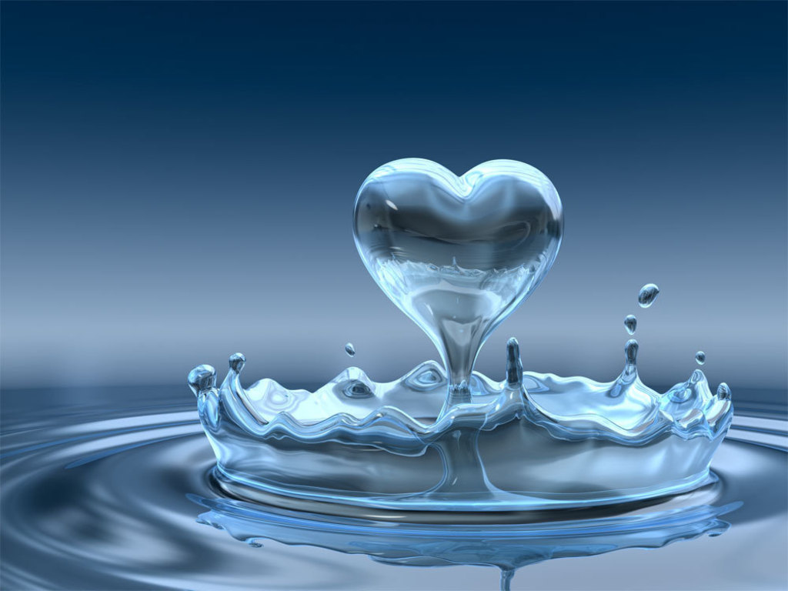
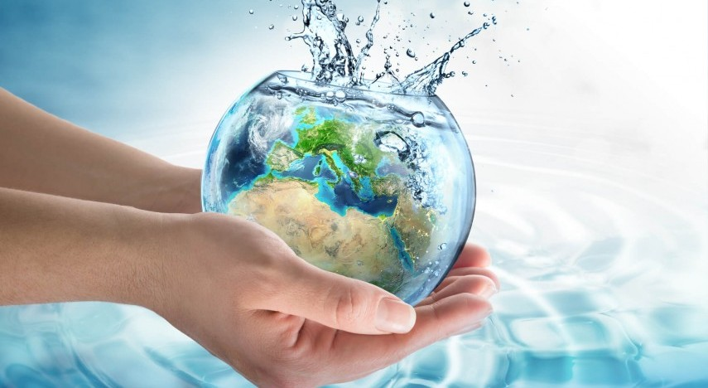
Ways to save water:
You should put a bottle of water or sand in the toilet cistern.
You shouldn’t put litter in the toilet.
When you brush your teeth you should use a glass of water to rinse. Don’t keep the tap on.
When you have a shower, you should keep the water on low power and don’t stay for more than 5 minutes.
You should refill your water bottle with tap or filtered water instead of buying a new bottle of mineral water.

