Slide 1
WATERAID REPORT
Web search instructions

Slide 2
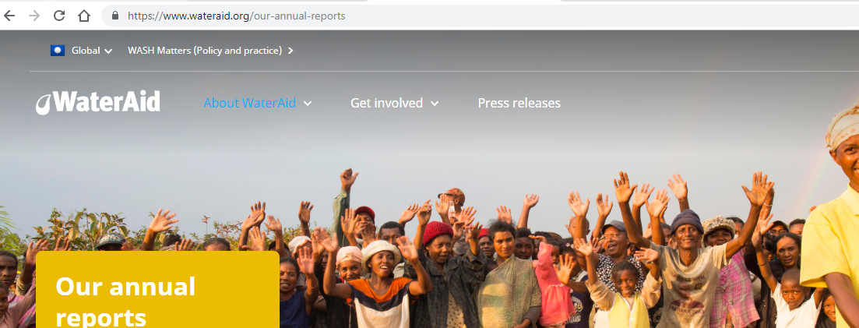
Go on this website: www.wateraid.org

Slide 3
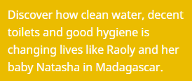

Slide 4
Find out: Thanks to Wateraid…….
How many people got clean water in households….
How many people got decent toilets in schools ….
How many people got clean water in healthcare centres….
How many people live in good health conditions in total ( in households, in schools and in helthcare centres)……….

Slide 5
How many …..?
…………… people don’t have a decent toilet ?
….. school days are lost every year because of water – related illnessess?
……… schools don’t have clear water?

Slide 6
Water Aid changes millions of lives every year, working in 28 countries to provide clean water, decent toilets and good hygiene
Which ones? Search in the WATER AID site and colour the countries on the map.

